Slide 1

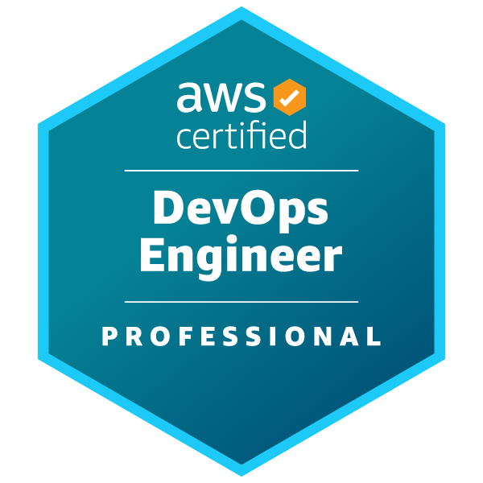





AWS Certified DevOps Engineer Professional
NO
T
F O R
D
I S T
R
I B
U
T I O
N
©
S
https://links.da https://links.dat
t e p
h a n
tacumulus.com acumulus.com/ a
e
Ma
aws-certified-
r
/aws-certified- ^{www}
e
k
devops-pro-pt-
devops-pro-
.
d
a
t a
httpsco://links.duatacpumuolus.cnom/aw coupon ^{u}
c
u m
https://links.datacumulus.com/aws l
s-certified-devops-pro-coupon ^{u}
-certified-devops-pro-pt-coupon
s
.
c o
© Stephane Maarek ^{m}
By Stéphane Maarek
https://links.data cumulus.com/aw s-certified- devops-pro- coupon
COURSE
EXTRA PRACTICE EXAMS

Slide 2
Disclaimer: These slides are copyrighted and strictly for personal use only
NOT FOR DISTRIBUTION © Stephane Maarek www.datacumulus.com
This document is reserved for people enrolled into the
AWS Certified DevOps Engineer Professional course by Stephane Maarek.
Please do not share this document, it is intended for personal use and exam preparation only, thank you.
If you’ve obtained these slides for free on a website that is not the course’s website, please reach out to piracy@datacumulus.com.Thanks!
Best of luck for the exam and happy learning!
© Stephane Maarek

Slide 3
AWS Certified DevOps Engineer Professional Course
DOP-C01
NOT FOR DISTRIBUTION © Stephane Maarek www.datacumulus.com
© Stephane Maarek

Slide 4
Please do not skip this lecture
NOT FOR DISTRIBUTION © Stephane Maarek www.datacumulus.com
ADVANCED, PROFESSIONAL-LEVEL COURSE
Do the AWS Certified Developer course & certification at a pre-requisite
It’ll be easier if you do the AWS Certified SysOps course & certification as well
ALL HANDS-ON
The AWS DevOps exam is hard and tests you on real-world experience (min 2 years)
This course provides you the opportunity to practice a lot
TAKE YOUR TIME
Practice as much as possible at work
Take notes for features or services you didn’t know about
Happy learning, and good luck for your exam!
© Stephane Maarek

Slide 5
NOT FOR DISTRIBUTION © Stephane Maarek www.datacumulus.com
Domain 1 - SDLC Automation
© Stephane Maarek

Slide 6
Continuous Integration
NOT FOR DISTRIBUTION © Stephane Maarek www.datacumulus.com
Developers push the code to a code
repository often (GitHub / CodeCommit / Bitbucket / etc…)
A testing / build server checks the code as
soon as it’s pushed (CodeBuild / Jenkins CI
/ etc…)
The developer gets feedback about the tests and checks that have passed / failed
Tell developer results of build
Push code often
Build Server
Code Repository
Find bugs early, fix bugs
Deliver faster as the code is tested
Deploy often
Happier developers, as they’re unblocked
Get code build & test
© Stephane Maarek

Slide 7
Continuous Delivery
NOT FOR DISTRIBUTION © Stephane Maarek www.datacumulus.com
Ensure that the software can be released reliably whenever needed.
Ensures deployments happen often and are quick
Shift away from “one release every 3 months” to ”5 releases a day”
That usually means automated deployment
CodeDeploy
Jenkins CD
Push code often
Code Repository
Get code build & test
Build Server
Deploy every passing build
Deployment Server
Spinnaker
Etc…
Application Server v1
Application Server v1
Application Server v1
Application Server v2
Application Server v2
Application Server v2
© Stephane Maarek

Slide 8
Continuous Delivery vs Continuous Deployment
NOT FOR DISTRIBUTION © Stephane Maarek www.datacumulus.com
Continuous Delivery:
Ability to deploy often using automation
May involve a manual step to “approve” a deployment
The deployment itself is still automated and repeated!
Continuous Deployment:
Full automation, every code change is deployed all the way to production
No manual intervention of approvals
© Stephane Maarek

Slide 9
Technology Stack for CICD
NOT FOR DISTRIBUTION © Stephane Maarek www.datacumulus.com
Code
Build
Test
Deploy
Provision
AWS
CodeCommit
AWS CodeBuild
AWS Elastic Beanstalk
AWS CodeDeploy | User Managed EC2 Instances Fleet (CloudFormation)
GitHub Or 3rd party
code repository
Jenkins CI
Or 3rd party CI servers
Orchestrate: AWS CodePipeline
© Stephane Maarek

Slide 10

CodeCommit
NOT FOR DISTRIBUTION © Stephane Maarek www.datacumulus.com
Version control is the ability to understand the various changes that happened to the code over time (and possibly roll back).
All these are enabled by using a version control system such as Git
A Git repository can live on one’s machine, but it usually lives on a central online repository
Benefits are:
Collaborate with other developers
Make sure the code is backed-up somewhere
Make sure it’s fully viewable and auditable
© Stephane Maarek

Slide 11
CodeCommit
NOT FOR DISTRIBUTION © Stephane Maarek www.datacumulus.com
Git repositories can be expensive.
The industry includes:
GitHub: free public repositories, paid private ones
BitBucket
Etc...
And AWS CodeCommit:
private Git repositories
No size limit on repositories (scale seamlessly)
Fully managed, highly available
Push code often
Code Repository
Code only in AWS Cloud account => increased security and compliance
Secure (encrypted, access control, etc…)
Integrated with Jenkins / CodeBuild / other CI tools
© Stephane Maarek

Slide 12

CodeBuild Overview
NOT FOR DISTRIBUTION © Stephane Maarek www.datacumulus.com
Fully managed build service
Alternative to other build tools such as Jenkins
Continuous scaling (no servers to manage or provision – no build queue)
Pay for usage: the time it takes to complete the builds
Leverages Docker under the hood for reproducible builds
Possibility to extend capabilities leveraging our own base Docker images
Secure: Integration with KMS for encryption of build artifacts, IAM for build permissions, and VPC for network security, CloudTrail for API calls logging
© Stephane Maarek

Slide 13
CodeBuild Overview
NOT FOR DISTRIBUTION © Stephane Maarek www.datacumulus.com
Source Code from GitHub / CodeCommit / CodePipeline / S3…
Build instructions can be defined in code (buildspec.yml file)
Output logs to Amazon S3 & AWS CloudWatch Logs
Metrics to monitor CodeBuild statistics
Use CloudWatch Events to detect failed builds and trigger notifications
Use CloudWatch Alarms to notify if you need “thresholds” for failures
CloudWatch Events / AWS Lambda as a Glue
SNS notifications
© Stephane Maarek

Slide 14
AWS CodeDeploy
NOT FOR DISTRIBUTION © Stephane Maarek www.datacumulus.com
We want to deploy our application automatically to many EC2 instances
There are several ways to handle deployments using open source tools (Ansible,Terraform, Chef, Puppet, etc…)
We can use the managed Service AWS CodeDeploy
v1
v2
v1
v2
v1
v2
v1
v2
© Stephane Maarek

Slide 15
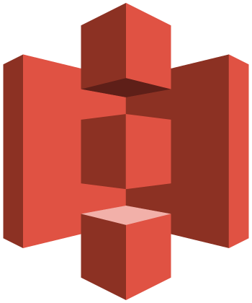


AWS CodeDeploy – Steps to make it work
NOT FOR DISTRIBUTION © Stephane Maarek www.datacumulus.com
Each EC2 Machine (or On Premise machine) must be running the CodeDeploy Agent
The agent is continuously polling AWS CodeDeploy for work to do
CodeDeploy sends appspec.yml
file.
Application is pulled from GitHub or S3
EC2 will run the deployment instructions
CodeDeploy Agent will report of
success / failure of deployment on the instance
GitHub
Source code
+
appspec.yml file
1. push
Amazon S3
4. Download code
+ appspec.yml file
2. Trigger deployment
3. poll
EC2 instances + agent
© Stephane Maarek

Slide 16
AWS CodeDeploy
NOT FOR DISTRIBUTION © Stephane Maarek www.datacumulus.com
EC2 instances are grouped by deployment group (dev / test / prod)
Lots of flexibility to define any kind of deployments
CodeDeploy can be chained into CodePipeline and use artifacts from there
CodeDeploy can re-use existing setup tools, works with any application, auto scaling integration
Note: Blue / Green only works with EC2 instances (not on premise)
Support for AWS Lambda deployments, EC2
CodeDeploy does not provision resources
© Stephane Maarek

Slide 17

CodePipeline
NOT FOR DISTRIBUTION © Stephane Maarek www.datacumulus.com
Continuous delivery
Visual workflow
Source: GitHub / CodeCommit / Amazon S3
Build: CodeBuild / Jenkins / etc…
Load Testing: 3rd party tools
Deploy: AWS CodeDeploy / Beanstalk / CloudFormation / ECS…
Made of stages:
Each stage can have sequential actions and / or parallel actions
Stages examples: Build / Test / Deploy / Load Test / etc…
Manual approval can be defined at any stage
© Stephane Maarek

Slide 18
Technology Stack for CICD
NOT FOR DISTRIBUTION © Stephane Maarek www.datacumulus.com
Code
Build
Test
Deploy
Provision
AWS
CodeCommit
AWS CodeBuild
AWS Elastic Beanstalk
AWS CodeDeploy | User Managed EC2 Instances Fleet (CloudFormation)
GitHub Or 3rd party
code repository
Jenkins CI
Or 3rd party CI servers
Orchestrate: AWS CodePipeline
© Stephane Maarek

Slide 19

AWS CodePipeline Artifacts
NOT FOR DISTRIBUTION © Stephane Maarek www.datacumulus.com
Each pipeline stage can create ”artifacts”
Artifacts are passed stored in Amazon S3 and passed on to the next stage
Source (CodeCommit)
Build (CodeBuild)
Deploy (CodeDeploy)
trigger
Output artifacts
Output artifacts
deploy
Input artifacts
Input artifacts
Amazon S3 bucket
© Stephane Maarek

Slide 20
Jenkins on AWS
NOT FOR DISTRIBUTION © Stephane Maarek www.datacumulus.com
Open Source CICD tool
Can replace CodeBuild, CodePipeline & CodeDeploy
Must be deployed in a Master / Slave configuration
Must manage multi-AZ, deploy on EC2, etc...
All projects must have a “Jenkinsfile” (similar to buildspec.yml) to tell Jenkins what to do
Jenkins can be extended on AWS thanks to many plugins!
© Stephane Maarek

Slide 21
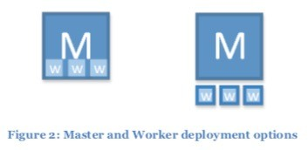
Jenkins Master / Slave (build farm)
NOT FOR DISTRIBUTION © Stephane Maarek www.datacumulus.com
From whitepaper: Jenkins on AWS https://d1.awsstatic.com/whitepapers/jenkins-on-aws.pdf
© Stephane Maarek

Slide 22
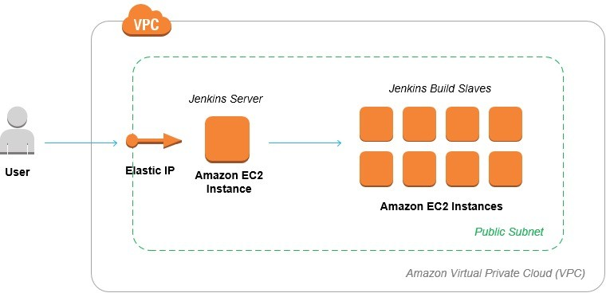
Jenkins on AWS
NOT FOR DISTRIBUTION © Stephane Maarek www.datacumulus.com
Source: https://aws.amazon.com/getting- started/projects/setup-jenkins-build-server/
© Stephane Maarek

Slide 23
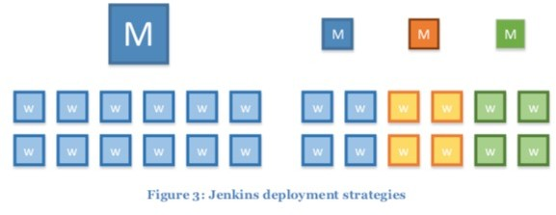
Jenkins Master / Slave
NOT FOR DISTRIBUTION © Stephane Maarek www.datacumulus.com
From whitepaper: Jenkins on AWS https://d1.awsstatic.com/whitepapers/jenkins-on-aws.pdf
© Stephane Maarek

Slide 24
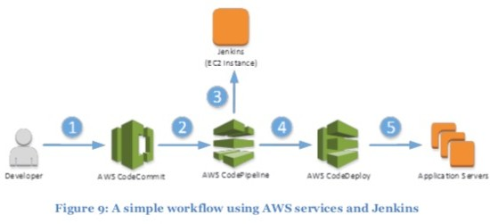
Jenkins with CodePipeline
NOT FOR DISTRIBUTION © Stephane Maarek www.datacumulus.com
From whitepaper: Jenkins on AWS https://d1.awsstatic.com/whitepapers/jenkins-on-aws.pdf
© Stephane Maarek

Slide 25
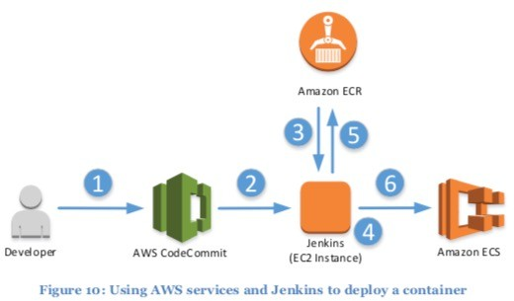
Jenkins with ECS
NOT FOR DISTRIBUTION © Stephane Maarek www.datacumulus.com
From whitepaper: Jenkins on AWS https://d1.awsstatic.com/whitepapers/jenkins-on-aws.pdf
© Stephane Maarek

Slide 26
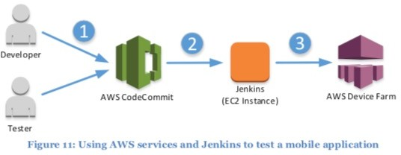
Jenkins with Device Farm
NOT FOR DISTRIBUTION © Stephane Maarek www.datacumulus.com
From whitepaper: Jenkins on AWS https://d1.awsstatic.com/whitepapers/jenkins-on-aws.pdf
© Stephane Maarek

Slide 27
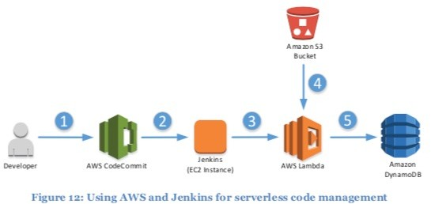
Jenkins with AWS Lambda
NOT FOR DISTRIBUTION © Stephane Maarek www.datacumulus.com
From whitepaper: Jenkins on AWS https://d1.awsstatic.com/whitepapers/jenkins-on-aws.pdf
© Stephane Maarek

Slide 28
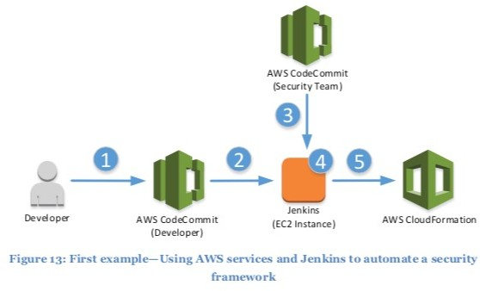
Jenkins with CloudFormation
NOT FOR DISTRIBUTION © Stephane Maarek www.datacumulus.com
From whitepaper: Jenkins on AWS https://d1.awsstatic.com/whitepapers/jenkins-on-aws.pdf
© Stephane Maarek

Slide 29
Infrastructure as Code
NOT FOR DISTRIBUTION © Stephane Maarek www.datacumulus.com
Currently, we have been doing a lot of manual work
All this manual work will be very tough to reproduce:
In another region
in another AWS account
Within the same region if everything was deleted
Wouldn’t it be great, if all our infrastructure was… code?
That code would be deployed and create / update / delete our infrastructure
© Stephane Maarek

Slide 30

What is CloudFormation
NOT FOR DISTRIBUTION © Stephane Maarek www.datacumulus.com
CloudFormation is a declarative way of outlining your AWS Infrastructure, for any resources (most of them are supported).
For example, within a CloudFormation template, you say:
I want a security group
I want two EC2 machines using this security group
I want two Elastic IPs for these EC2 machines
I want an S3 bucket
I want a load balancer (ELB) in front of these machines
Then CloudFormation creates those for you, in the right order, with the
exact configuration that you specify
© Stephane Maarek

Slide 31
Benefits of AWS CloudFormation (1/2)
NOT FOR DISTRIBUTION © Stephane Maarek www.datacumulus.com
Infrastructure as code
No resources are manually created, which is excellent for control
The code can be version controlled for example using git
Changes to the infrastructure are reviewed through code
Cost
Each resources within the stack is stagged with an identifier so you can easily see how much a stack costs you
You can estimate the costs of your resources using the CloudFormation template
Savings strategy: In Dev, you could automation deletion of templates at 5 PM and recreated at 8 AM, safely
© Stephane Maarek

Slide 32
Benefits of AWS CloudFormation (2/2)
NOT FOR DISTRIBUTION © Stephane Maarek www.datacumulus.com
Productivity
Ability to destroy and re-create an infrastructure on the cloud on the fly
Automated generation of Diagram for your templates!
Declarative programming (no need to figure out ordering and orchestration)
Separation of concern: create many stacks for many apps, and many layers. Ex:
VPC stacks
Network stacks
App stacks
Don’t re-invent the wheel
Leverage existing templates on the web!
Leverage the documentation
© Stephane Maarek

Slide 33
How CloudFormation Works
NOT FOR DISTRIBUTION © Stephane Maarek www.datacumulus.com
Templates have to be uploaded in S3 and then referenced in CloudFormation
To update a template, we can’t edit previous ones. We have to re- upload a new version of the template to AWS
Stacks are identified by a name
Deleting a stack deletes every single artifact that was created by CloudFormation.
© Stephane Maarek

Slide 34
Deploying CloudFormation templates
NOT FOR DISTRIBUTION © Stephane Maarek www.datacumulus.com
Manual way:
Editing templates in the CloudFormation Designer
Using the console to input parameters, etc
Automated way:
Editing templates in a YAML file
Using the AWS CLI (Command Line Interface) to deploy the templates
Recommended way when you fully want to automate your flow
© Stephane Maarek

Slide 35
CloudFormation Building Blocks
NOT FOR DISTRIBUTION © Stephane Maarek www.datacumulus.com
Templates components (one course section for each):
Resources: your AWS resources declared in the template (MANDATORY)
Parameters: the dynamic inputs for your template
Mappings: the static variables for your template
Outputs: References to what has been created
Conditionals: List of conditions to perform resource creation
Metadata
Templates helpers:
References
Functions
© Stephane Maarek

Slide 36
Note:
This is an introduction to CloudFormation
NOT FOR DISTRIBUTION © Stephane Maarek www.datacumulus.com
It can take over 3 hours to properly learn and master CloudFormation
This section is meant so you get a good idea of how it works
We’ll be slightly less hands-on than in other sections
We’ll learn everything we need to answer questions for the exam
The exam does not require you to actually write CloudFormation
The exam expects you to understand how to read CloudFormation
© Stephane Maarek

Slide 37
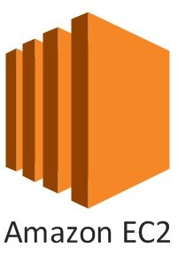
Introductory Example
NOT FOR DISTRIBUTION © Stephane Maarek www.datacumulus.com
We’re going to create a simple EC2 instance.
Then we’re going to create to add an Elastic IP to it
And we’re going to add two security groups to it
For now, forget about the code syntax.
We’ll look at the structure of the files later on
We’ll see how in no-time, we are able to get started with CloudFormation!
© Stephane Maarek

Slide 38
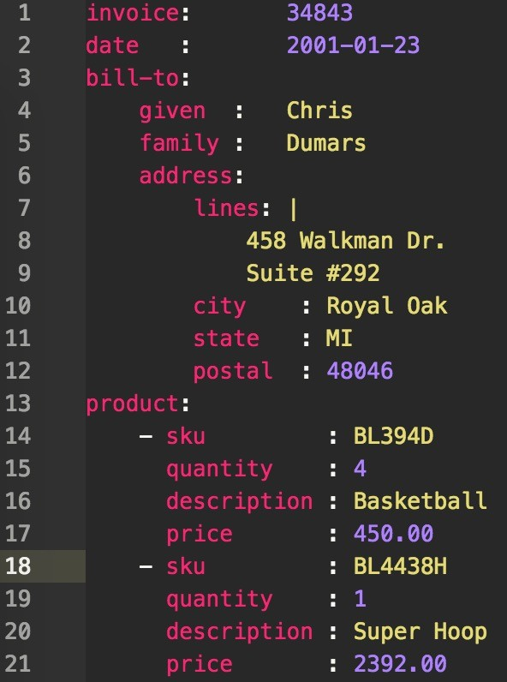
YAML Crash Course
NOT FOR DISTRIBUTION © Stephane Maarek www.datacumulus.com
YAML and JSON are the languages you can use for CloudFormation.
JSON is horrible for CF
YAML is great in so many ways
Let’s learn a bit about it!
Key value Pairs
Nested objects
Support Arrays
Multi line strings
Can include comments!
© Stephane Maarek

Slide 39
What are resources?
NOT FOR DISTRIBUTION © Stephane Maarek www.datacumulus.com
Resources are the core of your CloudFormation template (MANDATORY)
They represent the different AWS Components that will be created and configured
Resources are declared and can reference each other
AWS figures out creation, updates and deletes of resources for us
There are over 224 types of resources (!)
Resource types identifiers are of the form:
AWS::aws-product-name::data-type-name
© Stephane Maarek

Slide 40
How do I find
resources documentation?
NOT FOR DISTRIBUTION © Stephane Maarek www.datacumulus.com
I can’t teach you all of the 224 resources, but I can teach you how to learn how to use them.
All the resources can be found here: http://docs.aws.amazon.com/AWSCloudFormation/latest/UserGuide/aw s-template-resource-type-ref.html
Then, we just read the docs ☺
Example here (for an EC2 instance): http://docs.aws.amazon.com/AWSCloudFormation/latest/UserGuide/aw s-properties-ec2-instance.html
© Stephane Maarek

Slide 41
Analysis of CloudFormation Template
NOT FOR DISTRIBUTION © Stephane Maarek www.datacumulus.com
Going back to the example of the introductory section, let’s learn why it was written this way.
Relevant documentation can be found here:
http://docs.aws.amazon.com/AWSCloudFormation/latest/UserGuide/aws- properties-ec2-instance.html
http://docs.aws.amazon.com/AWSCloudFormation/latest/UserGuide/aws- properties-ec2-security-group.html
http://docs.aws.amazon.com/AWSCloudFormation/latest/UserGuide/aws- properties-ec2-eip.html
© Stephane Maarek

Slide 42
FAQ for resources
NOT FOR DISTRIBUTION © Stephane Maarek www.datacumulus.com
Can I create a dynamic amount of resources?
No, you can’t. Everything in the CloudFormation template has to be declared.You can’t perform code generation there
Is every AWS Service supported?
Almost. Only a select few niches are not there yet
You can work around that using AWS Lambda Custom Resources
© Stephane Maarek

Slide 43
What are parameters?
NOT FOR DISTRIBUTION © Stephane Maarek www.datacumulus.com
Parameters are a way to provide inputs to your AWS CloudFormation template
They’re important to know about if:
You want to reuse your templates across the company
Some inputs can not be determined ahead of time
Parameters are extremely powerful, controlled, and can prevent errors from happening in your templates thanks to types.
© Stephane Maarek

Slide 44
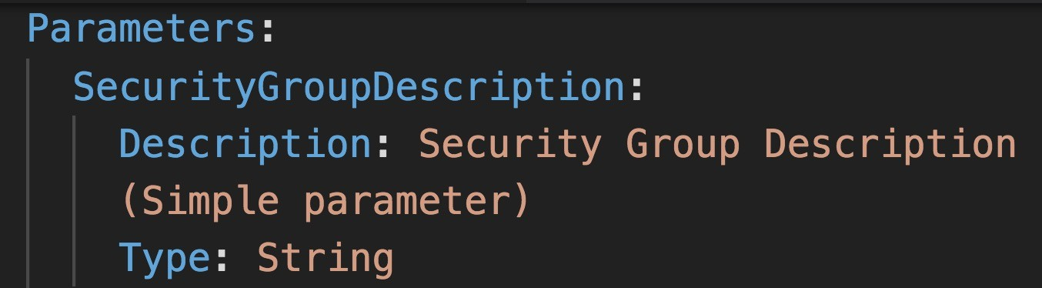
When should you use a parameter?
NOT FOR DISTRIBUTION © Stephane Maarek www.datacumulus.com
Ask yourself this:
Is this CloudFormation resource configuration likely to change in the future?
If so, make it a parameter.
You won’t have to re-upload a template to change its content ☺
© Stephane Maarek

Slide 45
Parameters Settings
NOT FOR DISTRIBUTION © Stephane Maarek www.datacumulus.com
Parameters can be controlled by all these settings:
Type:
String
Number
CommaDelimitedList
List<Type>
AWS Parameter (to help catch invalid values – match against existing values in the AWS Account)
Description
Constraints
ConstraintDescription (String)
Min/MaxLength
Min/MaxValue
Defaults
AllowedValues (array)
AllowedPattern (regexp)
NoEcho (Boolean)
© Stephane Maarek

Slide 46
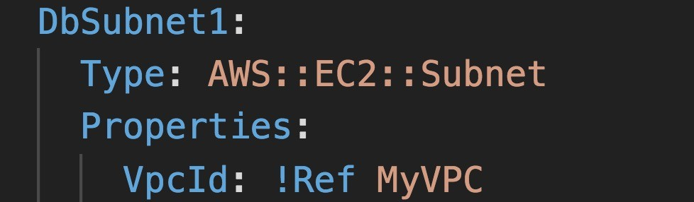
How to Reference a Parameter
NOT FOR DISTRIBUTION © Stephane Maarek www.datacumulus.com
The Fn::Ref function can be leveraged to reference parameters
Parameters can be used anywhere in a template.
The shorthand for this in YAML is !Ref
The function can also reference other elements within the template
© Stephane Maarek

Slide 47
Concept: Pseudo Parameters
NOT FOR DISTRIBUTION © Stephane Maarek www.datacumulus.com
AWS offers us pseudo parameters in any CloudFormation template.
These can be used at any time and are enabled by default
Reference Value | Example Return Value
AWS::AccountId | 1234567890
AWS::NotificationARNs | [arn:aws:sns:us-east- 1:123456789012:MyTopic]
AWS::NoValue | Does not return a value.
AWS::Region | us-east-2
AWS::StackId | arn:aws:cloudformation:us-east- 1:123456789012:stack/MyStack/1c2fa62 0-982a-11e3-aff7-50e2416294e0
AWS::StackName | MyStack
© Stephane Maarek

Slide 48
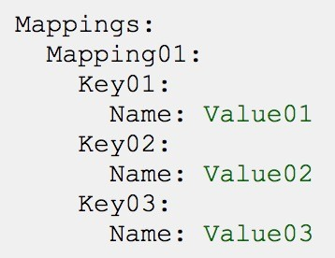
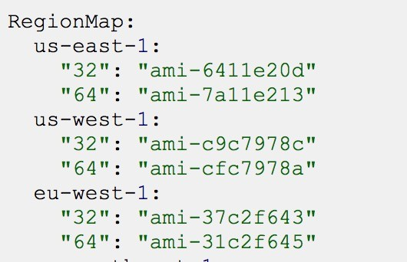
What are mappings?
NOT FOR DISTRIBUTION © Stephane Maarek www.datacumulus.com
Mappings are fixed variables within your CloudFormation Template.
They’re very handy to differentiate between different environments (dev vs prod), regions (AWS regions), AMI types, etc
All the values are hardcoded within the template
Example:
© Stephane Maarek

Slide 49
When would you use mappings vs parameters ?
NOT FOR DISTRIBUTION © Stephane Maarek www.datacumulus.com
Mappings are great when you know in advance all the values that can be taken and that they can be deduced from variables such as
Region
Availability Zone
AWS Account
Environment (dev vs prod)
Etc…
They allow safer control over the template.
Use parameters when the values are really user specific
© Stephane Maarek

Slide 50
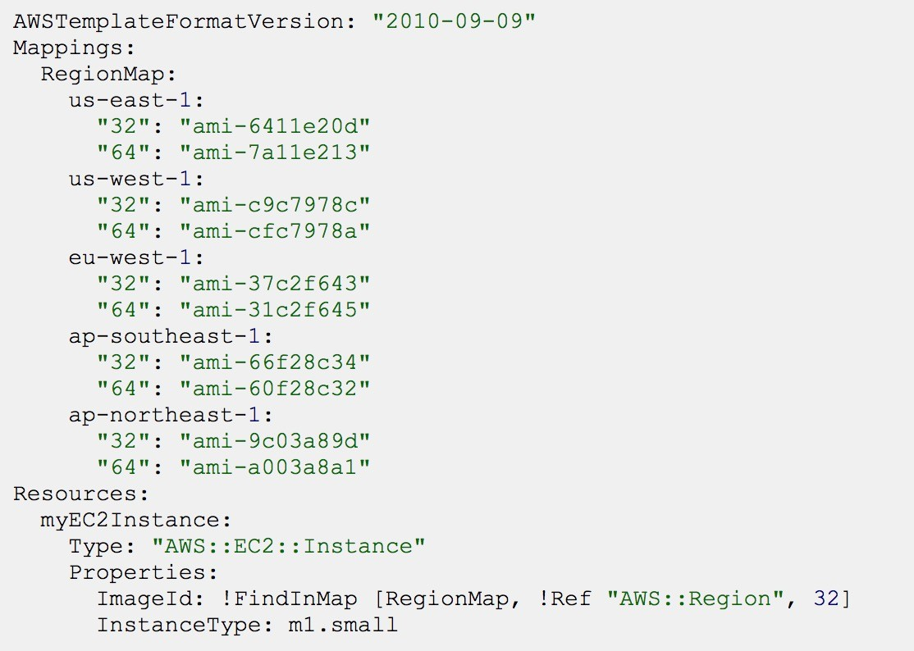
Fn::FindInMap
Accessing Mapping Values
NOT FOR DISTRIBUTION © Stephane Maarek www.datacumulus.com
We use Fn::FindInMap to return a named value from a specific key
!FindInMap [ MapName, TopLevelKey, SecondLevelKey ]
© Stephane Maarek

Slide 51
What are outputs?
NOT FOR DISTRIBUTION © Stephane Maarek www.datacumulus.com
The Outputs section declares optional outputs values that we can import into other stacks (if you export them first)!
You can also view the outputs in the AWS Console or in using the AWS CLI
They’re very useful for example if you define a network CloudFormation, and output the variables such as VPC ID and your Subnet IDs
It’s the best way to perform some collaboration cross stack, as you let expert handle their own part of the stack
You can’t delete a CloudFormation Stack if its outputs are being referenced by another CloudFormation stack
© Stephane Maarek

Slide 52
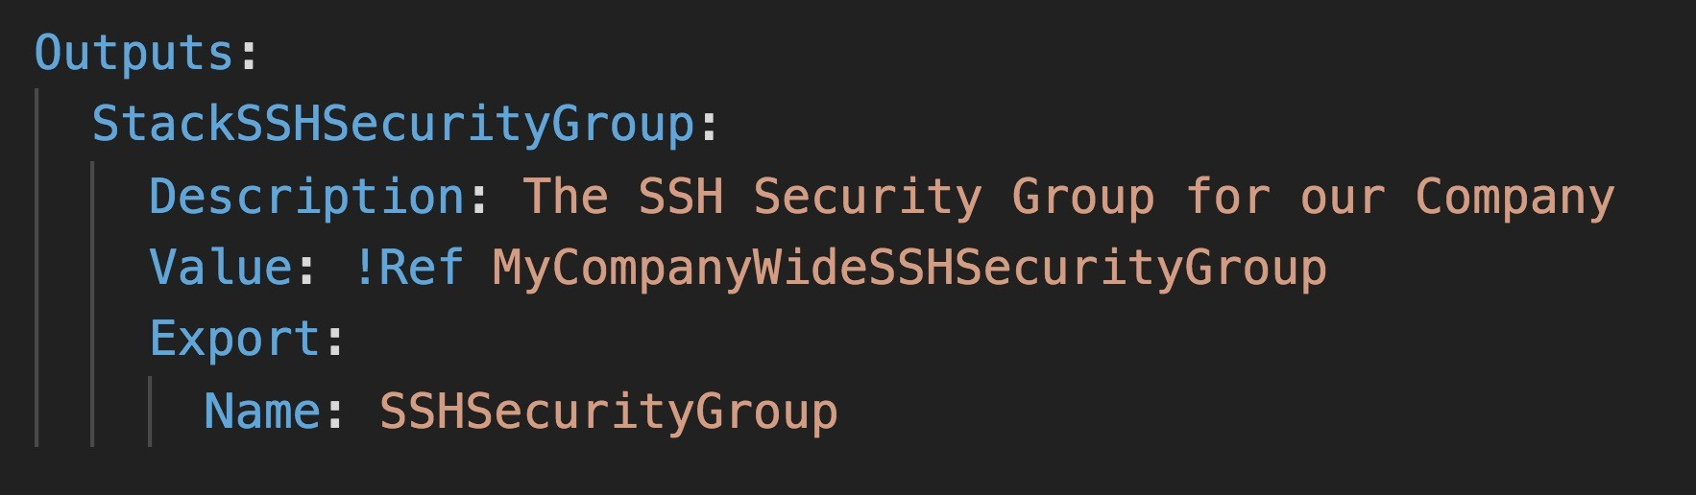
Outputs Example
NOT FOR DISTRIBUTION © Stephane Maarek www.datacumulus.com
Creating a SSH Security Group as part of one template
We create an output that references that security group
© Stephane Maarek

Slide 53
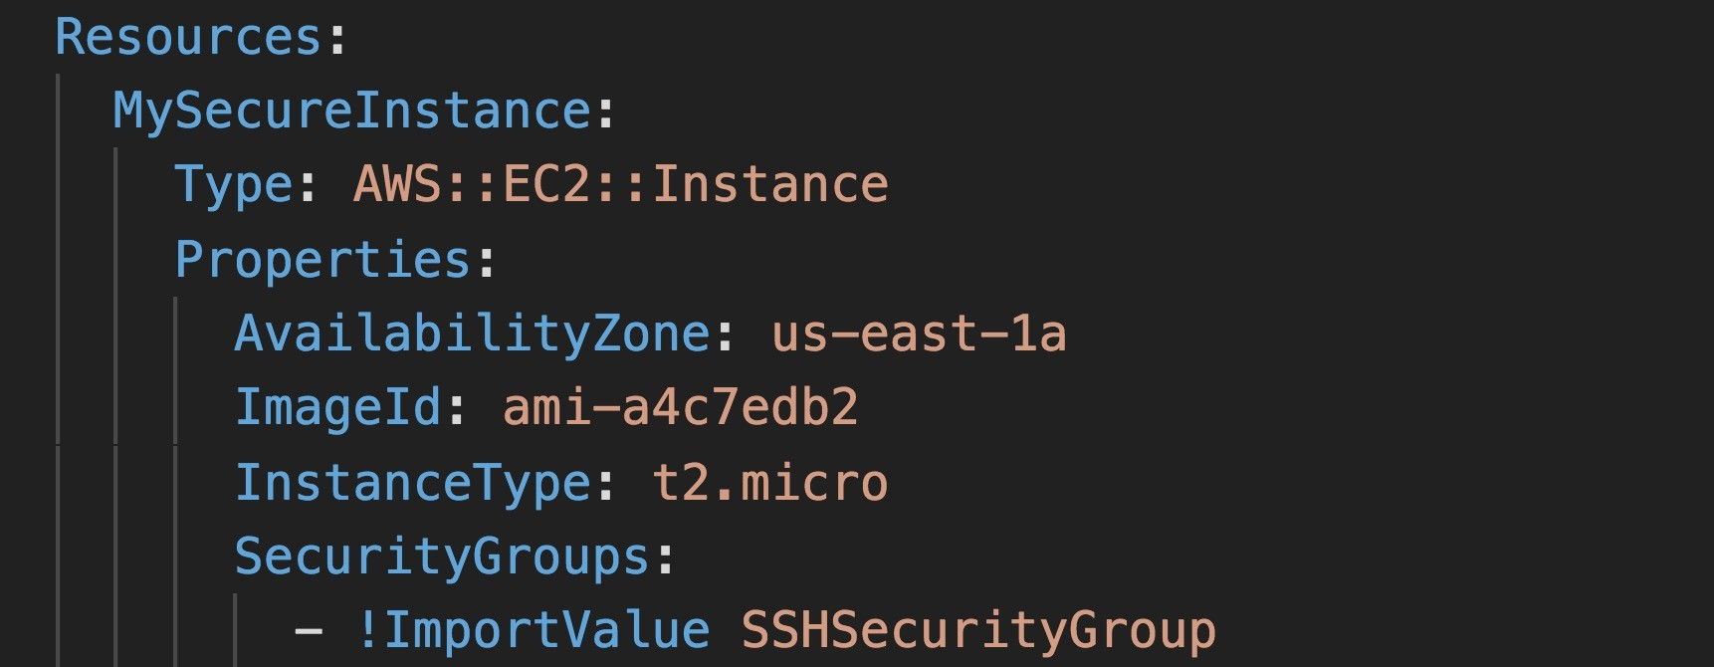
Cross Stack Reference
NOT FOR DISTRIBUTION © Stephane Maarek www.datacumulus.com
We then create a second template that leverages that security group
For this, we use the Fn::ImportValue function
You can’t delete the underlying stack until all the references are deleted too.
© Stephane Maarek

Slide 54
What are conditions used for?
NOT FOR DISTRIBUTION © Stephane Maarek www.datacumulus.com
Conditions are used to control the creation of resources or outputs based on a condition.
Conditions can be whatever you want them to be, but common ones are:
Environment (dev / test / prod)
AWS Region
Any parameter value
Each condition can reference another condition, parameter value or mapping
© Stephane Maarek

Slide 55
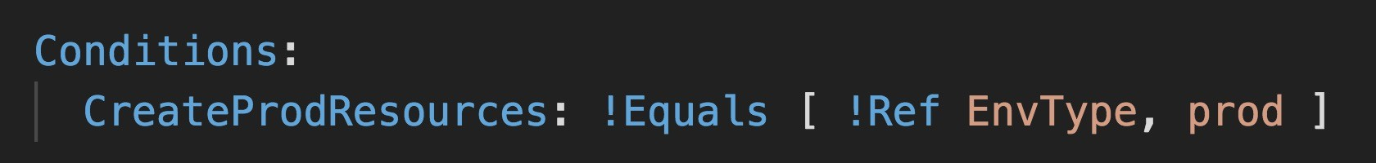
How to define a condition?
NOT FOR DISTRIBUTION © Stephane Maarek www.datacumulus.com
The logical ID is for you to choose. It’s how you name condition
The intrinsic function (logical) can be any of the following:
Fn::And
Fn::Equals
Fn::If
Fn::Not
Fn::Or
© Stephane Maarek

Slide 56
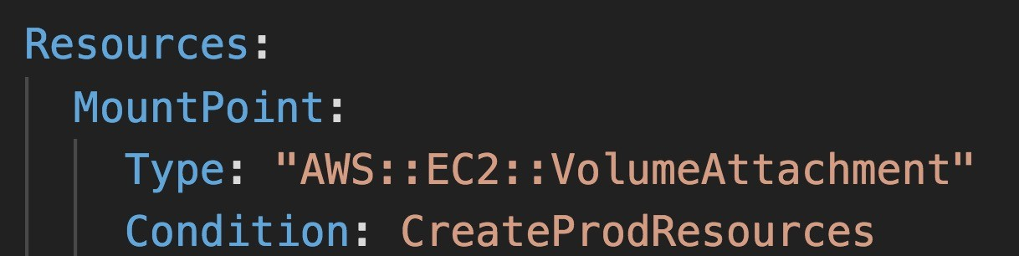
Using a Condition
NOT FOR DISTRIBUTION © Stephane Maarek www.datacumulus.com
Conditions can be applied to resources / outputs / etc…
© Stephane Maarek

Slide 57
CloudFormation
Must Know Intrisic Functions
NOT FOR DISTRIBUTION © Stephane Maarek www.datacumulus.com
Ref
Fn::GetAtt
Fn::FindInMap
Fn::ImportValue
Fn::Join
Fn::Sub
Condition Functions (Fn::If, Fn::Not, Fn::Equals, etc…)
© Stephane Maarek

Slide 58
Fn::Ref
NOT FOR DISTRIBUTION © Stephane Maarek www.datacumulus.com
The Fn::Ref function can be leveraged to reference
Parameters => returns the value of the parameter
Resources => returns the physical ID of the underlying resource (ex: EC2 ID)
The shorthand for this in YAML is !Ref
© Stephane Maarek

Slide 59
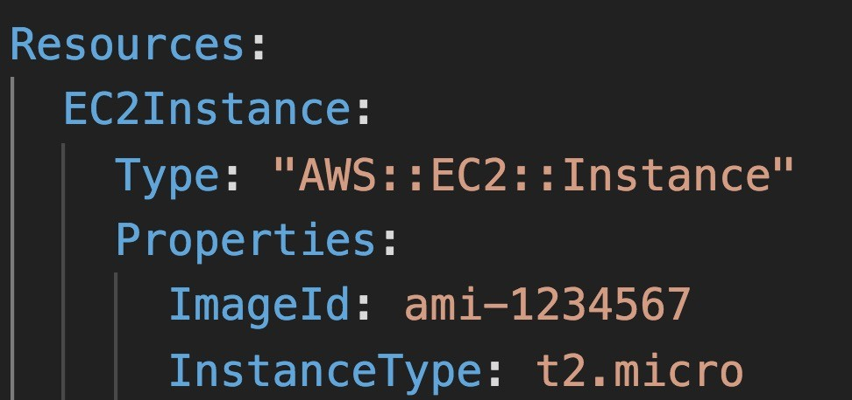
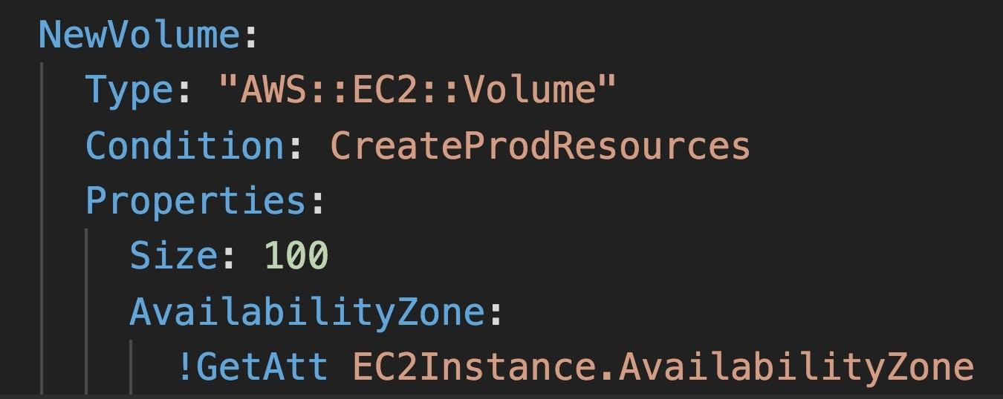
Fn::GetAtt
NOT FOR DISTRIBUTION © Stephane Maarek www.datacumulus.com
Attributes are attached to any resources you create
To know the attributes of your resources, the best place to look at is the documentation.
For example: the AZ of an EC2 machine!
© Stephane Maarek

Slide 60
Fn::FindInMap
Accessing Mapping Values
NOT FOR DISTRIBUTION © Stephane Maarek www.datacumulus.com
We use Fn::FindInMap to return a named value from a specific key
!FindInMap [ MapName, TopLevelKey, SecondLevelKey ]
© Stephane Maarek

Slide 61
Fn::ImportValue
NOT FOR DISTRIBUTION © Stephane Maarek www.datacumulus.com
Import values that are exported in other templates
For this, we use the Fn::ImportValue function
© Stephane Maarek

Slide 62
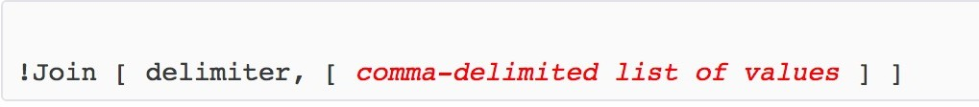
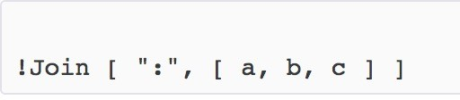
Fn::Join
NOT FOR DISTRIBUTION © Stephane Maarek www.datacumulus.com
Join values with a delimiter
This creates “a:b:c”
© Stephane Maarek

Slide 63
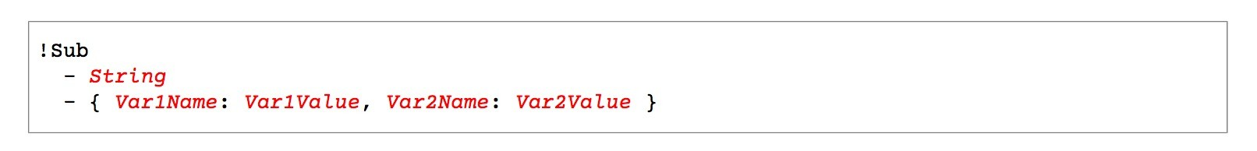
Function Fn::Sub
NOT FOR DISTRIBUTION © Stephane Maarek www.datacumulus.com
Fn::Sub, or !Sub as a shorthand, is used to substitute variables from a text. It’s a very handy function that will allow you to fully customize your templates.
For example, you can combine Fn::Sub with References or AWS Pseudo variables!
String must contain ${VariableName} and will substitute them
© Stephane Maarek

Slide 64
Condition Functions
NOT FOR DISTRIBUTION © Stephane Maarek www.datacumulus.com
The logical ID is for you to choose. It’s how you name condition
The intrinsic function (logical) can be any of the following:
Fn::And
Fn::Equals
Fn::If
Fn::Not
Fn::Or
© Stephane Maarek

Slide 65
User Data in EC2 for CloudFormation
NOT FOR DISTRIBUTION © Stephane Maarek www.datacumulus.com
We can have user data at EC2 instance launch through the console
We can also include it in CloudFormation
The important thing to pass is the entire script through the function Fn::Base64
Good to know: user data script log is in /var/log/cloud-init-output.log
Let’s see how to do this in CloudFormation
© Stephane Maarek

Slide 66
cfn-init
NOT FOR DISTRIBUTION © Stephane Maarek www.datacumulus.com
AWS::CloudFormation::Init must be in the Metadata of a resource
With the cfn-init script, it helps make complex EC2 configurations readable
The EC2 instance will query the CloudFormation service to get init data
Logs go to /var/log/cfn-init.log
CloudFormation Service
Retrieve init data
launch
EC2 instance
Let’s see how it works through a sample CloudFormation
Run cfn-init
© Stephane Maarek

Slide 67
cfn-signal & wait conditions
NOT FOR DISTRIBUTION © Stephane Maarek www.datacumulus.com
Wait condition
We still don’t know how to tell CloudFormation that the EC2 instance got properly configured after a cfn-init
CloudFormation Service
For this, we can use the cfn-signal script!
We run cfn-signal right after cfn-init
Tell CloudFormation service to keep on going or fail
We need to define WaitCondition:
Block the template until it receives a signal from cfn- signal
We attach a CreationPolicy (also works on EC2, ASG)
Retrieve init data
Signal from cfn-signal
launch
EC2 instance
Run cfn-init
© Stephane Maarek

Slide 68
Wait Condition Didn't Receive the Required Number of Signals from an Amazon EC2 Instance
NOT FOR DISTRIBUTION © Stephane Maarek www.datacumulus.com
Ensure that the AMI you're using has the AWS CloudFormation helper scripts
installed. If the AMI doesn't include the helper scripts, you can also download them to your instance.
Verify that the cfn-init & cfn-signal command was successfully run on the instance.
You can view logs, such as /var/log/cloud-init.log or /var/log/cfn-init.log, to help you debug the instance launch.
You can retrieve the logs by logging in to your instance, but you must disable
rollback on failure or else AWS CloudFormation deletes the instance after your stack fails to create.
Verify that the instance has a connection to the Internet. If the instance is in a VPC,
the instance should be able to connect to the Internet through a NAT device if it's is in a private subnet or through an Internet gateway if it's in a public subnet.
For example, run: curl -I https://aws.amazon.com
© Stephane Maarek

Slide 69
Rollbacks on failures
NOT FOR DISTRIBUTION © Stephane Maarek www.datacumulus.com
Stack Creation Fails: (CreateStack API)
Default: everything rolls back (gets deleted). We can look at the log
OnFailure=ROLLBACK
Troubleshoot: Option to disable rollback and manually troubleshoot
OnFailure=DO_NOTHING
Delete: get rid of the stack entirely, do not keep anything
OnFailure=DELETE
Stack Update Fails: (UpdateStack API)
The stack automatically rolls back to the previous known working state
Ability to see in the log what happened and error messages
© Stephane Maarek

Slide 70
Nested stacks
NOT FOR DISTRIBUTION © Stephane Maarek www.datacumulus.com
Nested stacks are stacks as part of other stacks
They allow you to isolate repeated patterns / common components in separate stacks and call them from other stacks
Example:
Load Balancer configuration that is re-used
Security Group that is re-used
Nested stacks are considered best practice
To update a nested stack, always update the parent (root stack)
© Stephane Maarek

Slide 71

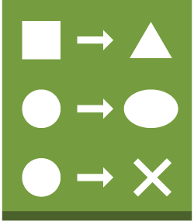
ChangeSets
NOT FOR DISTRIBUTION © Stephane Maarek www.datacumulus.com
When you update a stack, you need to know what changes before it happens for greater confidence
ChangeSets won’t say if the update will be successful
1. Create Change set
2. View Change set
4. Execute Change set
Original stack
change set
change set
AWS CloudFormation
3. (optional) Create Additional change sets
From: https://docs.aws.amazon.com/AWSCloudFormation/latest/UserGuide/using-cfn-updating-stacks- changesets.html
© Stephane Maarek

Slide 72
Retaining Data on Deletes
NOT FOR DISTRIBUTION © Stephane Maarek www.datacumulus.com
You can put a DeletionPolicy on any resource to control what happens when the CloudFormation template is deleted
DeletionPolicy=Retain:
Specify on resources to preserve / backup in case of CloudFormation deletes
To keep a resource, specify Retain (works for any resource / nested stack)
DeletionPolicy=Snapshot:
EBS Volume, ElastiCache Cluster, ElastiCache ReplicationGroup
RDS DBInstance, RDS DBCluster, Redshift Cluster
DeletePolicy=Delete (default behavior):
Note: for AWS::RDS::DBCluster resources, the default policy is Snapshot
Note: to delete an S3 bucket, you need to first empty the bucket of its content
© Stephane Maarek

Slide 73
Termination Protection on Stacks
NOT FOR DISTRIBUTION © Stephane Maarek www.datacumulus.com
To prevent accidental deletes of CloudFormation templates, use TerminationProtection
Let’s see this quickly!
© Stephane Maarek

Slide 74
CloudFormation Custom Resources (Lambda)
NOT FOR DISTRIBUTION © Stephane Maarek www.datacumulus.com
You can define a Custom Resource in CloudFormation to address any of these use cases:
CloudFormation Custom Resource
An AWS resource is yet not covered (new service for example)
An On-Premise resource
Emptying an S3 bucket before being deleted
Fetch an AMI id
Anything you want…!
Create, update, delete
AWS Lambda Function
API calls
Whatever you want
© Stephane Maarek

Slide 75
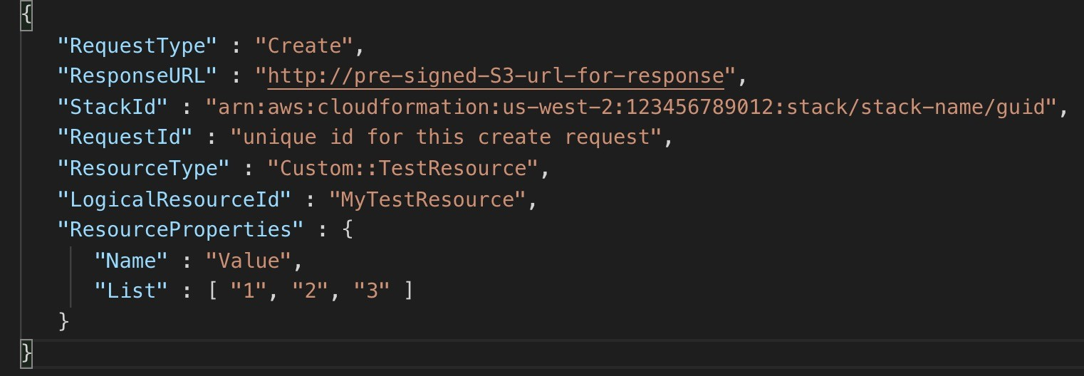
CloudFormation Custom Resources (Lambda)
NOT FOR DISTRIBUTION © Stephane Maarek www.datacumulus.com
The Lambda Function will get invoked only if there is a Create, Update or Delete event, not every time you run the template
© Stephane Maarek

Slide 76






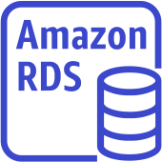
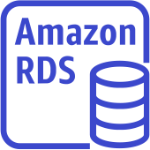

Elastic Beanstalk Deployment Modes
NOT FOR DISTRIBUTION © Stephane Maarek www.datacumulus.com
Single Instance Great for dev
High Availability with Load Balancer Great for prod
Availability Zone 1
Elastic IP
EC2 Instance
RDS Master
Availability Zone 1
ALB
Availability Zone 2
Auto Scaling Group
EC2 Instance
EC2 Instance
RDS Master
RDS Standby
© Stephane Maarek

Slide 77
Beanstalk Deployment Options for Updates
NOT FOR DISTRIBUTION © Stephane Maarek www.datacumulus.com
All at once (deploy all in one go) – fastest, but instances aren’t available to serve traffic for a bit (downtime)
Rolling: update a few instances at a time (bucket), and then move onto the next bucket once the first bucket is healthy
Rolling with additional batches: like rolling, but spins up new instances to move the batch (so that the old application is still available)
Immutable: spins up new instances in a new ASG, deploys version to these instances, and then swaps all the instances when everything is healthy
© Stephane Maarek

Slide 78
Elastic Beanstalk Deployment All at once
NOT FOR DISTRIBUTION © Stephane Maarek www.datacumulus.com
Fastest deployment
Application has downtime
Great for quick iterations in development environment
No additional cost
v1
v2
v1
v2
v1
v2
v1
v2
© Stephane Maarek

Slide 79
Elastic Beanstalk Deployment Rolling
NOT FOR DISTRIBUTION © Stephane Maarek www.datacumulus.com
Application is
running below capacity
Can set the bucket size
Application is
running both versions simultaneously
No additional cost
Long deployment
v1
v2
v2
v2
Bucket (size 2)
v1
v2
v2
v2
v1
v1
Bucket (size 2)
v1
v2
v1
v1
v1
v2
© Stephane Maarek

Slide 80
Elastic Beanstalk Deployment Rolling with additional batches
NOT FOR DISTRIBUTION © Stephane Maarek www.datacumulus.com
Application is running at capacity
Can set the bucket size
Application is running
both versions simultaneously
Small additional cost
Additional batch is removed at the end of the deployment
Longer deployment
Good for prod
v1
v1
v2
v2
v2
v2
v1
v1
v2
v2
v2
v2
v1
v1
v1
v1
v2
v2
v1
v1
v1
v1
v2
v2
new
v2
v2
v2
v2
v2
terminated
new
v2
v2
v2
v2
v2
terminated
© Stephane Maarek

Slide 81
Elastic Beanstalk Deployment
NOT FOR DISTRIBUTION © Stephane Maarek www.datacumulus.com
Immutable
Zero downtime
New Code is deployed to new instances on a temporary ASG
High cost, double capacity
Longest deployment
Quick rollback in case of failures (just terminate new ASG)
Great for prod
Current ASG
Current ASG
Current ASG
Current ASG
v1
v1
v1
V1 terminated
v1
v1
v1
v1
v1
v1
v2
v2
v2
v2
v2
v2
v2
v2
v2
© Stephane Maarek
Temp ASG
Temp ASG

Slide 82


Elastic Beanstalk Deployment Blue / Green
NOT FOR DISTRIBUTION © Stephane Maarek www.datacumulus.com
Not a “direct feature” of Elastic Beanstalk
Zero downtime and release facility
Create a new “stage” environment and deploy v2 there
The new environment (green) can be
validated independently and roll back if issues
Route 53 can be setup using weighted
policies to redirect a little bit of traffic to the stage environment
Using Beanstalk, “swap URLs” when done with the environment test
Environment “blue”
v1
v1
v1
90 %
Web traffic
Environment “green”
v2
10 %
Amazon Route 53
v2
v2
© Stephane Maarek

Slide 83
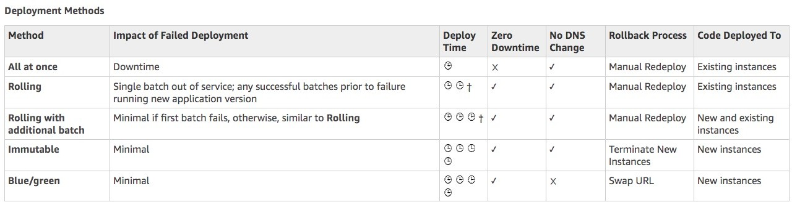
Elastic Beanstalk Deployment Summary from AWS Doc
NOT FOR DISTRIBUTION © Stephane Maarek www.datacumulus.com
https://docs.aws.amazon.com/elasticbeanstalk/latest/dg/using- features.deploy-existing-version.html
© Stephane Maarek

Slide 84
AWS Lambda Versions
NOT FOR DISTRIBUTION © Stephane Maarek www.datacumulus.com
When you work on a Lambda function, we work on $LATEST
When we’re ready to publish a Lambda function, we create a version
Versions are immutable
Versions have increasing version numbers
Versions get their own ARN (Amazon Resource Name)
Version = code + configuration (nothing can be changed - immutable)
Each version of the lambda function can be accessed
$LATEST
(mutable)
V1
(Immutable)
V2
(Immutable)
© Stephane Maarek

Slide 85
AWS Lambda Aliases
NOT FOR DISTRIBUTION © Stephane Maarek www.datacumulus.com
Aliases are ”pointers” to Lambda function versions
We can define a “dev”, ”test”,
“prod” aliases and have them point at different lambda versions
Aliases are mutable
Aliases enable Blue / Green
deployment by assigning weights to lambda functions
Aliases enable stable configuration of our event triggers / destinations
Aliases have their own ARNs
Users
DEV Alias (mutable)
PROD Alias (mutable)
TEST Alias (mutable)
95%
5%
$LATEST
(mutable)
V1
(Immutable)
V2
(Immutable)
© Stephane Maarek

Slide 86
API Gateway – Deployment Stages
NOT FOR DISTRIBUTION © Stephane Maarek www.datacumulus.com
Making changes in the API Gateway does not mean they’re effective
You need to make a “deployment” for them to be in effect
It’s a common source of confusion
Changes are deployed to “Stages” (as many as you want)
Use the naming you like for stages (dev, test, prod)
Each stage has its own configuration parameters
Stages can be rolled back as a history of deployments is kept
© Stephane Maarek

Slide 87

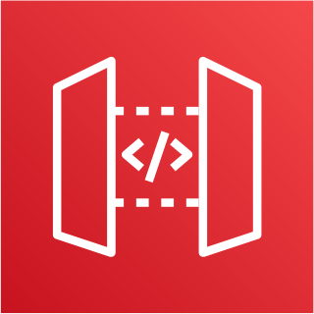


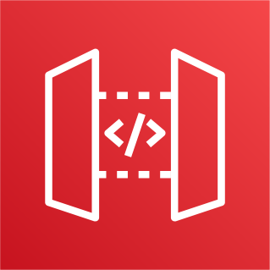

API Gateway – Stages v1 and v2 API breaking change
NOT FOR DISTRIBUTION © Stephane Maarek www.datacumulus.com
https://api.example.com/v1
v1 Stage
V1
V1 Client
New URL!
https://api.example.com/v2
v2 Stage
V2
V2 Client
© Stephane Maarek

Slide 88
API Gateway – Stage Variables
NOT FOR DISTRIBUTION © Stephane Maarek www.datacumulus.com
Stage variables are like environment variables for API Gateway
Use them to change often changing configuration values
They can be used in:
Lambda function ARN
HTTP Endpoint
Parameter mapping templates
Use cases:
Configure HTTP endpoints your stages talk to (dev, test, prod…)
Pass configuration parameters to AWS Lambda through mapping templates
Stage variables are passed to the ”context” object in AWS Lambda
© Stephane Maarek

Slide 89
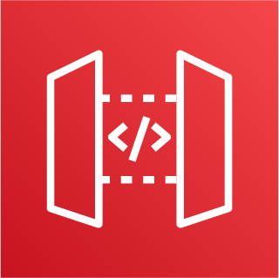


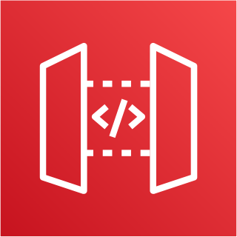


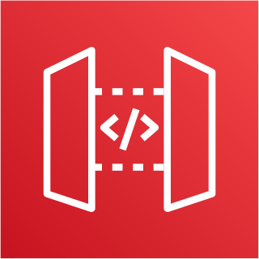


API Gateway Stage Variables & Lambda Aliases
NOT FOR DISTRIBUTION © Stephane Maarek www.datacumulus.com
We create a stage variable to indicate the corresponding Lambda alias
Our API gateway will automatically invoke the right Lambda function!
PROD Alias
Prod Stage 95%
V1
TEST Alias
5%
Lambda alias changes
No API Gateway changes
Test Stage
100%
V2
DEV Alias
Dev Stage
100%
$LATEST
© Stephane Maarek

Slide 90
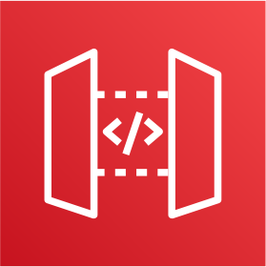


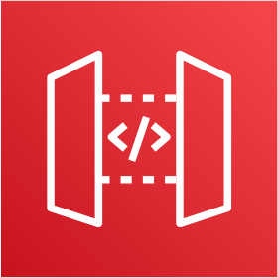

API Gateway – Canary Deployment
NOT FOR DISTRIBUTION © Stephane Maarek www.datacumulus.com
Possibility to enable canary deployments for any stage (usually prod)
Choose the % of traffic the canary channel receives
Prod Stage
95%
v1
Client
5%
Prod Stage Canary
v2
Metrics & Logs are separate (for better monitoring)
Possibility to override stage variables for canary
This is blue / green deployment with AWS Lambda & API Gateway
© Stephane Maarek

Slide 91
AWS Step Functions – When to Use?
NOT FOR DISTRIBUTION © Stephane Maarek www.datacumulus.com
Use to design workflows
Easy visualizations
Advanced Error Handling and Retry mechanism outside the code
Audit of the history of workflows
Ability to “Wait” for an arbitrary amount of time
Max execution time of a State Machine is 1 year
Example:
Payment Workflow
Complex flows
Long running workflows (days) to go over the Lambda limit of 15 minutes
© Stephane Maarek

Slide 92
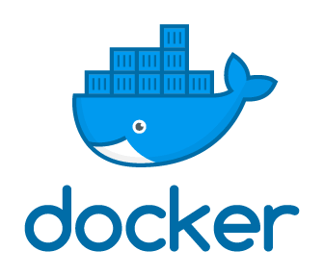
What is Docker?
NOT FOR DISTRIBUTION © Stephane Maarek www.datacumulus.com
Docker is a software development platform to deploy apps
Apps are packaged in containers that can be run on any OS
Apps run the same, regardless of where they’re run
Any machine
No compatibility issues
Predictable behavior
Less work
Easier to maintain and deploy
Works with any language, any OS, any technology
© Stephane Maarek

Slide 93
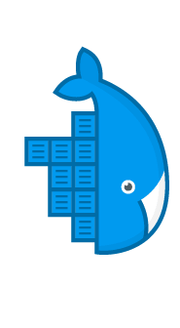



NOT FOR DISTRIBUTION © Stephane Maarek www.datacumulus.com
Server (ex: EC2 Instance)
Docker on an OS
© Stephane Maarek

Slide 94
Where Docker images are stored?
NOT FOR DISTRIBUTION © Stephane Maarek www.datacumulus.com
Docker images are stored in Docker Repositories
Public: Docker Hub https://hub.docker.com/
Find base images for many technologies or OS:
Ubuntu
MySQL
NodeJS, Java…
Private: Amazon ECR (Elastic Container Registry)
© Stephane Maarek

Slide 95
Docker versus Virtual Machines
NOT FOR DISTRIBUTION © Stephane Maarek www.datacumulus.com
Docker is ”sort of” a virtualization technology, but not exactly
Resources are shared with the host => many containers on one server
Apps
Apps
Apps
Container
Container
Container
Guest OS (VM)
Guest OS (VM)
Guest OS (VM)
Container
Container
Container
Container
Container
Container
Hypervisor
Docker Daemon
Host OS
Host OS (EC2 Instance)
Infrastructure
Infrastructure
© Stephane Maarek

Slide 96

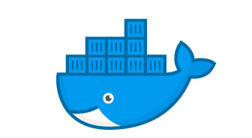


Getting Started with Docker
NOT FOR DISTRIBUTION © Stephane Maarek www.datacumulus.com
Download Docker at: https://www.docker.com/get-started
build
run
Docker Image
Dockerfile
Docker Container
push
pull
Docker Hub
Amazon ECR
© Stephane Maarek

Slide 97
Docker Containers Management
NOT FOR DISTRIBUTION © Stephane Maarek www.datacumulus.com
To manage containers, we need a container management platform
Three choices:
ECS: Amazon’s own platform
Fargate: Amazon’s own Serverless platform
EKS: Amazon’s managed Kubernetes (open source)
© Stephane Maarek

Slide 98
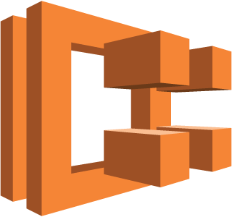
ECS Clusters Overview
NOT FOR DISTRIBUTION © Stephane Maarek www.datacumulus.com
ECS Clusters are logical grouping of EC2 instances
EC2 instances run the ECS agent (Docker container)
The ECS agents registers the instance to the ECS cluster
The EC2 instances run a special AMI, made specifically for ECS
ECS Agent
register
ECS Cluster
EC2 instance
© Stephane Maarek

Slide 99

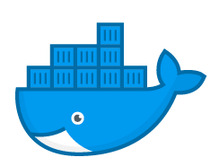
ECS Task Definitions
NOT FOR DISTRIBUTION © Stephane Maarek www.datacumulus.com
www
Host port
Tasks definitions are metadata in JSON form to tell ECS how to run a Docker Container
It contains crucial information around:
Image Name
Port Binding for Container and Host
Memory and CPU required
Environment variables
Networking information
IAM Role
Logging configuration (ex CloudWatch)
8080
80
Container port
httpd
ECS Agent
EC2 instance
© Stephane Maarek

Slide 100
ECS Service
NOT FOR DISTRIBUTION © Stephane Maarek www.datacumulus.com
ECS Services help define how many tasks should run and how they should be run
They ensure that the number of tasks desired is running across our fleet of EC2 instances.
They can be linked to ELB / NLB / ALB if needed
Let’s make our first service!
© Stephane Maarek

Slide 101
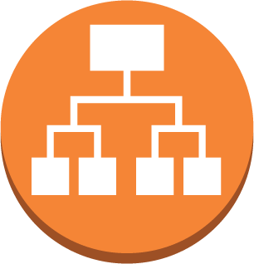
ECS Service with Load Balancer
NOT FOR DISTRIBUTION © Stephane Maarek www.datacumulus.com
32698
32667
80
www
80
httpd
httpd
32657
32713
80
80
httpd
httpd
Application Load Balancer
ECS Agent
ECS Agent
With dynamic port forwarding
EC2 instance
EC2 instance
© Stephane Maarek

Slide 102
ECR
NOT FOR DISTRIBUTION © Stephane Maarek www.datacumulus.com
So far we’ve been using Docker images from Docker Hub (public)
ECR is a private Docker image repository
Access is controlled through IAM (permission errors => policy)
You need to run some commands to push pull:
$(aws ecr get-login --no-include-email --region eu-west-1)
docker push 1234567890.dkr.ecr.eu-west-1.amazonaws.com/demo:latest
docker pull 1234567890.dkr.ecr.eu-west-1.amazonaws.com/demo:latest
© Stephane Maarek

Slide 103
Fargate
NOT FOR DISTRIBUTION © Stephane Maarek www.datacumulus.com
When launching an ECS Cluster, we have to create our EC2 instances
If we need to scale, we need to add EC2 instances
So we manage infrastructure…
With Fargate, it’s all Serverless!
We don’t provision EC2 instances
We just create task definitions, and AWS will run our containers for us
To scale, just increase the task number. Simple! No more EC2 ☺
© Stephane Maarek

Slide 104
Elastic Beanstalk + ECS
NOT FOR DISTRIBUTION © Stephane Maarek www.datacumulus.com
You can run Elastic Beanstalk in Single & Multi Docker Container mode
Multi Docker helps run multiple containers per EC2 instance in EB
This will create for you:
ECS Cluster
EC2 instances, configured to use the ECS Cluster
Load Balancer (in high availability mode)
Task definitions and execution
Requires a config file Dockerrun.aws.json at the root of source code
Your Docker images must be pre-built and stored in ECR for example
© Stephane Maarek

Slide 105
Elastic Beanstalk + ECS
NOT FOR DISTRIBUTION © Stephane Maarek www.datacumulus.com
Elastic Beanstalk Environment
ECS Cluster + ASG
EC2
Instance
EC2
Instance
php Container
nginx Container
other Container
Load Balancer
beanstalk-url:80
php Container
Port 80
beanstalk-url:1234
nginx Container
Port 1234
other Container
© Stephane Maarek

Slide 106

AWS Kinesis Overview
NOT FOR DISTRIBUTION © Stephane Maarek www.datacumulus.com
Kinesis is a managed alternative to Apache Kafka
Great for application logs, metrics, IoT, clickstreams
Great for “real-time” big data
Great for streaming processing frameworks (Spark, NiFi, etc…)
Data is automatically replicated to 3 AZ
Kinesis Streams: low latency streaming ingest at scale
Kinesis Analytics: perform real-time analytics on streams using SQL
Kinesis Firehose: load streams into S3, Redshift, ElasticSearch…
© Stephane Maarek

Slide 107


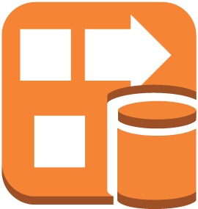
Kinesis Example
NOT FOR DISTRIBUTION © Stephane Maarek www.datacumulus.com
Amazon Kinesis
Click
Streams
IoT
devices
Amazon S3 bucket
Amazon Kinesis Streams
Amazon Kinesis Analytics
Amazon Kinesis Firehose
Metrics
& Logs
© Stephane Maarek

Slide 108
Kinesis Streams Overview
NOT FOR DISTRIBUTION © Stephane Maarek www.datacumulus.com
Streams are divided in ordered Shards / Partitions
Shard 1
Shard 2
Shard 3
producers
consumers
Data retention is 1 day by default, can go up to 7 days
Ability to reprocess / replay data
Multiple applications can consume the same stream
Real-time processing with scale of throughput
Once data is inserted in Kinesis, it can’t be deleted (immutability)
© Stephane Maarek

Slide 109
Kinesis Streams Shards
NOT FOR DISTRIBUTION © Stephane Maarek www.datacumulus.com
One stream is made of many different shards
Billing is per shard provisioned, can have as many shards as you want
Batching available or per message calls.
The number of shards can evolve over time (reshard / merge)
Records are ordered per shard
Shard 1
Shard 2
Shard 3
Shard 4
producers
consumers
© Stephane Maarek

Slide 110
Kinesis Streams Records
NOT FOR DISTRIBUTION © Stephane Maarek www.datacumulus.com
Data Blob: data being sent, serialized as
bytes. Up to 1 MB. Can represent anything
Record Key:
sent alongside a record, helps to group records in Shards. Same key = Same shard.
Use a highly distributed key to avoid the “hot partition” problem
Sequence number: Unique identifier for each records put in shards. Added by Kinesis after ingestion
Data Blob (up to 1MB) Bytes
Record Key
Sequence Number
© Stephane Maarek

Slide 111
Kinesis Data Streams Limits to know
NOT FOR DISTRIBUTION © Stephane Maarek www.datacumulus.com
Producer:
1MB/s or 1000 messages/s at write PER SHARD
“ProvisionedThroughputException” otherwise
Consumer Classic:
2MB/s at read PER SHARD across all consumers
5 API calls per second PER SHARD across all consumers
• = if 3 different applications are consuming, possibility of throttling
Data Retention:
24 hours data retention by default
Can be extended to 7 days
© Stephane Maarek

Slide 112






Kinesis Producers
NOT FOR DISTRIBUTION © Stephane Maarek www.datacumulus.com
Kinesis SDK
Kinesis Producer Library (KPL)
Kinesis Agent
SDK
CloudWatch Logs
Kinesis Producer Library (KPL)
Amazon Kinesis Streams
3rd party libraries: Spark, Log4J Appenders, Flume, Kafka Connect, NiFi…
Kinesis Agent
CloudWatch Logs
© Stephane Maarek

Slide 113

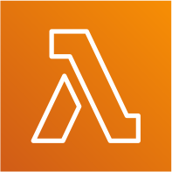




Kinesis Consumers
NOT FOR DISTRIBUTION © Stephane Maarek www.datacumulus.com
Kinesis SDK
Kinesis Client Library (KCL)
Kinesis Connector Library
Kinesis Firehose
Firehose
AWS Lambda
AWS Lambda
3rd party libraries: Spark, Log4J Appenders, Flume, Kafka Connect…
Kinesis Consumer Library (KCL)
Amazon Kinesis Streams
SDK
Kinesis Collector Library
© Stephane Maarek

Slide 114


AWS Kinesis KCL
NOT FOR DISTRIBUTION © Stephane Maarek www.datacumulus.com
KCL uses DynamoDB to checkpoint offsets
KCL uses DynamoDB to track other workers and share the work amongst shards
Great for reading in a distributed manner
Consume messages
Amazon Kinesis– enabled app
Checkpoint progress
Consume messages
Amazon Kinesis– enabled app
Amazon DynamoDB
© Stephane Maarek

Slide 115

AWS Kinesis Data Firehose
NOT FOR DISTRIBUTION © Stephane Maarek www.datacumulus.com
Fully Managed Service, no administration
Near Real Time (60 seconds latency minimum for non full batches)
Load data into Redshift / Amazon S3 / ElasticSearch / Splunk
Automatic scaling
Data Transformation through AWS Lambda (ex: CSV => JSON)
Supports compression when target is Amazon S3 (GZIP, ZIP, and SNAPPY)
Pay for the amount of data going through Firehose
© Stephane Maarek

Slide 116




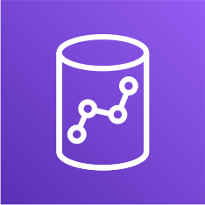




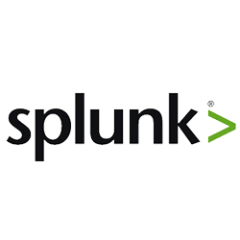

Kinesis Data Firehose Diagram
NOT FOR DISTRIBUTION © Stephane Maarek www.datacumulus.com
SDK
Kinesis Producer Library (KPL)
Amazon S3
Lambda function
Kinesis Agent
Redshift
Kinesis Data Streams
Amazon Kinesis Data Firehose
ElasticSearch
CloudWatch Logs & Events
IoT rules actions
© Stephane Maarek

Slide 117
Kinesis Data Streams vs Firehose
NOT FOR DISTRIBUTION © Stephane Maarek www.datacumulus.com
Streams
Going to write custom code (producer / consumer)
Real time (~200 ms latency for classic)
Must manage scaling (shard splitting / merging)
Data Storage for 1 to 7 days, replay capability, multi consumers
Use with Lambda to insert data in real-time to ElasticSearch (for example)
Firehose
Fully managed, send to S3, Splunk, Redshift, ElasticSearch
Serverless data transformations with Lambda
Near real time (lowest buffer time is 1 minute)
Automated Scaling
No data storage
© Stephane Maarek

Slide 118
AWS Kinesis Data Analytics
NOT FOR DISTRIBUTION © Stephane Maarek www.datacumulus.com
Perform real-time analytics on Kinesis Streams using SQL
Kinesis Data Analytics:
Auto Scaling
Managed: no servers to provision
Continuous: real time
Pay for actual consumption rate
Can create streams out of the real-time queries
© Stephane Maarek

Slide 119
All kind of Logs
NOT FOR DISTRIBUTION © Stephane Maarek www.datacumulus.com
Application Logs
Logs that are produced by your application code
Contains custom log messages, stack traces, and so on
Written to a local file on the filesystem
Usually streamed to CloudWatch Logs using a CloudWatch Agent on EC2
If using Lambda, direct integration with CloudWatch Logs
If using ECS or Fargate, direct integration with CloudWatch Logs
If using Elastic Beanstalk, direct integration with CloudWatch Logs
Operating System Logs (Event Logs, System Logs)
Logs that are generated by your operating system (EC2 or on-premise instance)
Informing you of system behavior (ex: /var/log/messages or /var/log/auth.log)
Usually streamed to CloudWatch Logs using a CloudWatch Agent
© Stephane Maarek

Slide 120
All kind of Logs
NOT FOR DISTRIBUTION © Stephane Maarek www.datacumulus.com
Access Logs
list of all the requests for individual files that people have requested from a website
Example for httpd: /var/log/apache/access.log
Usually for load balancers, proxies, web servers, etc…
AWS provides some access logs
© Stephane Maarek

Slide 121
AWS Managed Logs
NOT FOR DISTRIBUTION © Stephane Maarek www.datacumulus.com
Load Balancer Access Logs (ALB, NLB, CLB) => to S3
Access logs for your Load Balancers
CloudTrail Logs => to S3 and CloudWatch Logs
Logs for API calls made within your account
VPC Flow Logs => to S3 and CloudWatch Logs
Information about IP traffic going to and from network interfaces in your VPC
Route 53 Access Logs => to CloudWatch Logs
Log information about the queries that Route 53 receives
S3 Access Logs => to S3
Server access logging provides detailed records for the requests that are made to a bucket
CloudFront Access Logs => to S3
Detailed information about every user request that CloudFront receives
© Stephane Maarek

Slide 122

Amazon ElasticSearch
NOT FOR DISTRIBUTION © Stephane Maarek www.datacumulus.com
May be called Amazon ES at the exam
Managed version of ElasticSearch (open source project)
Needs to run on servers (not a serverless offering)
Use cases:
Log Analytics
Real Time application monitoring
Security Analytics
Full Text Search
Clickstream Analytics
Indexing
© Stephane Maarek

Slide 123
ElasticSearch + Kibana + Logstash
NOT FOR DISTRIBUTION © Stephane Maarek www.datacumulus.com
ElasticSearch: provide search and indexing capability
You must specify instance types, multi-AZ, etc
Kibana:
Provide real-time dashboards on top of the data that sits in ES
Alternative to CloudWatch dashboards (more advanced capabilities)
Logstash:
Log ingestion mechanism, use the “Logstash Agent”
Alternative to CloudWatch Logs (you decide on retention and granularity)
© Stephane Maarek

Slide 124
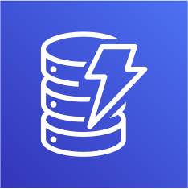
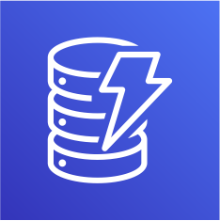


Elastic Search patterns DynamoDB
NOT FOR DISTRIBUTION © Stephane Maarek www.datacumulus.com
DynamoDB Table
DynamoDB Stream
Lambda Function
Amazon ES
API to retrieve items
API to search items
© Stephane Maarek

Slide 125








Elastic Search patterns CloudWatch Logs
NOT FOR DISTRIBUTION © Stephane Maarek www.datacumulus.com
Real time
CloudWatch Logs
Subscription Filter
Lambda Function (managed by AWS)
Amazon ES
Near Real Time
CloudWatch Logs
Subscription Filter
Kinesis Data Firehose
Amazon ES
© Stephane Maarek

Slide 126

AWS Systems Manager Overview
NOT FOR DISTRIBUTION © Stephane Maarek www.datacumulus.com
Helps you manage your EC2 and On-Premise systems at scale
Get operational insights about the state of your infrastructure
Easily detect problems
Patching automation for enhanced compliance
Works for both Windows and Linux OS
Integrated with CloudWatch metrics / dashboards
Integrated with AWS Config
Free service
© Stephane Maarek

Slide 127
AWS Systems Manager Features
NOT FOR DISTRIBUTION © Stephane Maarek www.datacumulus.com
Resource Groups
Insights:
Insights Dashboard
Inventory: discover and audit the software installed
Compliance
Parameter Store
Action:
Automation (shut down EC2, create AMIs)
Run Command
Session Manager
Patch Manager
Maintenance Windows
State Manager: define and maintaining configuration of OS and applications
© Stephane Maarek

Slide 128
How Systems Manager works
NOT FOR DISTRIBUTION © Stephane Maarek www.datacumulus.com
We need to install the SSM agent onto the systems we control
Installed by default on Amazon
Linux AMI & some Ubuntu AMI
If an instance can’t be controlled with SSM, it’s
probably an issue with the SSM agent!
Make sure the EC2 instances
have a proper IAM role to allow SSM actions
SSM
SSM Agent
SSM Agent
SSM Agent
EC2 Instance
EC2 Instance
On Premise VM
© Stephane Maarek

Slide 129

AWS Service Catalog
NOT FOR DISTRIBUTION © Stephane Maarek www.datacumulus.com
Users that are new to AWS have too many options, and may create stacks that are not compliant / in line with the rest of the organization
Some users just want a quick self-service portal to launch a set of
authorized products pre-defined by admins
Includes: virtual machines, databases, storage options, etc…
Enter AWS Service Catalog!
© Stephane Maarek

Slide 130


Service Catalog diagram
NOT FOR DISTRIBUTION © Stephane Maarek www.datacumulus.com
ADMIN TASKS
Product Portfolio
Control
CloudFormation Templates
Collection of Products
IAM Permissions to Access Portfolios
USER TASKS
Product List
Provisioned Products
launch
Authorized by IAM
Ready to use Properly Configured Properly Tagged
© Stephane Maarek

Slide 131
AWS Service Catalog
NOT FOR DISTRIBUTION © Stephane Maarek www.datacumulus.com
Create and manage catalogs of IT services that are approved on AWS
The “products” are CloudFormation templates
Ex:Virtual machine images, Servers, Software, Databases, Regions, IP address ranges
CloudFormation helps ensure consistency, and standardization by Admins
They are assigned to Portfolios (teams)
Teams are presented a self-service portal where they can launch the products
All the deployed products are centrally managed deployed services
Helps with governance, compliance, and consistency
Can give user access to launching products without requiring deep AWS knowledge
Integrations with “self-service portals” such as ServiceNow
© Stephane Maarek

Slide 132
EC2 Instance Compliance
NOT FOR DISTRIBUTION © Stephane Maarek www.datacumulus.com
AWS Config
ensure instance has proper AWS configuration (not open SSH port, etc)
Audit and compliance over time
Inspector
Security Vulnerabilities scan from within the OS using the agent
Or outside network scanning (no need for the agent)
Systems Manager
Run automations, patches, commands, inventory at scale
Service Catalog
Restrict how the EC2 instances can be launched to minimize configurations
Helpful to onboard beginner AWS users
Configuration Management
SSM, Opsworks, Ansible, Chef, Puppet, User Data
Ensure the EC2 instances have proper configuration files
© Stephane Maarek

Slide 133
GuardDuty
NOT FOR DISTRIBUTION © Stephane Maarek www.datacumulus.com
Intelligent Threat discovery to Protect AWS Account
Uses Machine Learning algorithms, anomaly detection, 3rd party data
One click to enable (30 days trial), no need to install software
Input data includes:
CloudTrail Logs: unusual API calls, unauthorized deployments
VPC Flow Logs: unusual internal traffic, unusual IP address
DNS Logs: compromised EC2 instances sending encoded data within DNS queries
Notifies you in case of findings
Integration with AWS Lambda
© Stephane Maarek

Slide 134
AWS Cost Allocation Tags
NOT FOR DISTRIBUTION © Stephane Maarek www.datacumulus.com
With Tags we can track resources that relate to each other
With Cost Allocation Tags we can enable detailed costing reports
Just like Tags, but they show up as columns in Reports
AWS Generated Cost Allocation Tags
Automatically applied to the resource you create
Starts with Prefix aws: (e.g. aws: createdBy)
They’re not applied to resources created before the activation
User tags
Defined by the user
Starts with Prefix user :
Cost Allocation Tags just appear in the Billing Console
Takes up to 24 hours for the tags to show up in the report
© Stephane Maarek

Slide 135
AWS Data Protection
NOT FOR DISTRIBUTION © Stephane Maarek www.datacumulus.com
TLS for in transit encryption
ACM to manage SSL / TLS certificates
Load Balancers
ELB, ALB & NLB provide SSL termination
Possible to have multiple SSL certificates per ALB
Optional SSL/TLS encryption between ALB and EC2 instances (else, HTTP)
CloudFront with SSL
All AWS services expose HTTPS endpoints
You *could* (but *shouldn’t*) use HTTP with S3
© Stephane Maarek

Slide 136
AWS Data Protection At Rest Encryption
NOT FOR DISTRIBUTION © Stephane Maarek www.datacumulus.com
S3 encryption
SSE-S3: Server Side encryption using AWS’ key
SSE-KMS: Server Side encryption using your own KMS key
SSE-C: Server Side encryption by providing your own key (AWS won’t keep it)
Client side encryption: send encrypted content to AWS, no knowledge of key
Possibility to enable default encryption on S3 through setting
Possibility to enforce encryption through S3 bucket policy (x-amz-server-side-encryption)
Glacier is encrypted by default
One quick setting for: EBS, EFS, RDS, ElastiCache, DynamoDB, etc
Usually uses either service encryption key or your own KMS key
Category of data:
PHI = protected health information
PII = personally-identifying information
© Stephane Maarek

Slide 137
AWS Network Protection
NOT FOR DISTRIBUTION © Stephane Maarek www.datacumulus.com
Direct Connect: private, direct connection between site and AWS
Public internet: use a VPN
Site-to-Site VPN supports Internet Protocol security (IPsec) VPN connections (for linking on-premise to the cloud)
Network ACL: stateless firewall at the VPC level
WAF (Web Application Firewall): web security rules against exploits
Security Groups: stateful firewall on the instance’s underlying hypervisor
System Firewalls: install your own firewall on EC2 instances
© Stephane Maarek

Slide 138
Coverage for Domain 5
NOT FOR DISTRIBUTION © Stephane Maarek www.datacumulus.com
Troubleshoot issues and determine how to restore operations
CloudWatch, CloudFormation, Rollbacks, etc.
Determine how to automate event management and alerting + Apply concepts required to set up event-driven automated actions
CloudWatch Events+++, CloudWatch Alarms, SNS
Automated Healing:
CloudFormation (triggered by an alarm)
Beanstalk (easier)
OpsWorks (automatic host replacement, manages the infrastructure)
Autoscaling (we'll see in this section)
© Stephane Maarek

Slide 139






Deployment Strategies Auto Scaling and ALB
NOT FOR DISTRIBUTION © Stephane Maarek www.datacumulus.com
In place (one LB, one TG, one ASG)
ALB
ALB
Auto Scaling group
Instance, running v1
Auto Scaling group
Same instance, running v2
CodeDeploy
© Stephane Maarek

Slide 140




Deployment Strategies Auto Scaling and ALB
NOT FOR DISTRIBUTION © Stephane Maarek www.datacumulus.com
Rolling (one LB, one TG, one ASG, new instances)
ALB
Auto Scaling group
Instance, running v1
New Instance, running v2
© Stephane Maarek

Slide 141



Deployment Strategies Auto Scaling and ALB
NOT FOR DISTRIBUTION © Stephane Maarek www.datacumulus.com
Replace (one LB, one TG, two ASG, new instances)
ALB
Auto Scaling group
Instance, running v1
New Auto Scaling group
New instance, v2
© Stephane Maarek

Slide 142







Deployment Strategies Auto Scaling and ALB
NOT FOR DISTRIBUTION © Stephane Maarek www.datacumulus.com
Blue / Green (two LB, two TG, two ASG, new instances, R53)
Amazon Route 53 record Simple, Weighted
ALB
ALB
Auto Scaling group
Instance, running v1
Auto Scaling group
New instance, v2
© Stephane Maarek

Slide 143
Deployment strategies
NOT FOR DISTRIBUTION © Stephane Maarek www.datacumulus.com
Read more here:
Blue/Green Deployments on AWS whitepaper, August 2016
https://d1.awsstatic.com/whitepapers/AWS_Blue_Green_Deployments.pdf
© Stephane Maarek

Slide 144



DynamoDB Patterns S3 Metadata Index
NOT FOR DISTRIBUTION © Stephane Maarek www.datacumulus.com
writes
Amazon S3
Lambda Function
DynamoDB Table
API for object metadata
Search by date
Total storage used by a customer
List of all objects with certain attributes
Find all objects uploaded within a date range
© Stephane Maarek

Slide 145
DynamoDB patterns Elastic Search
NOT FOR DISTRIBUTION © Stephane Maarek www.datacumulus.com
DynamoDB Table
DynamoDB Stream
Lambda Function
Amazon ES
API to retrieve items
API to search items
© Stephane Maarek

Slide 146
Multi AZ in AWS
NOT FOR DISTRIBUTION © Stephane Maarek www.datacumulus.com
Services where Multi-AZ must be enabled manually:
EFS, ELB, ASG, Beanstalk: assign AZ
RDS, ElastiCache: multi-AZ (synchronous standby DB for failovers)
Aurora:
data is stored automatically across multi-AZ
Can have multi-AZ for the DB itself (same as RDS)
ElasticSearch (managed): multi master
Jenkins (self deployed): multi master
Service where Multi-AZ is implicitly there:
S3 (except OneZone-Infrequent Access)
DynamoDB
All of AWS’ proprietary, managed services
© Stephane Maarek

Slide 147








What about EBS?
NOT FOR DISTRIBUTION © Stephane Maarek www.datacumulus.com
EBS is tied to a single AZ
How can you make EBS “multi-AZ” ?
ASG with 1 min/max/desired
Lifecycle hooks for Terminate: make a snapshot of the EBS volume
Lifecycle hook for start: copy the snapshot, create an EBS, attach to instance
Note: for PIOPS volumes (io1), to get max performance after snapshot, read the entire volume once (pre- warming of IO blocks)
Availability Zone 1
Availability Zone 2
Auto Scaling group
Min/max/desired = 1
Old Instance
New Instance
Terminate Hook
Launch Hook
EBS Volume
EBS Volume
backup
create
Snapshot
© Stephane Maarek

Slide 148
Multi Region Services
NOT FOR DISTRIBUTION © Stephane Maarek www.datacumulus.com
DynamoDB Global Tables (multi-way replication, enabled by Streams)
AWS Config Aggregators (multi region & multi account)
RDS Cross Region Read Replicas (used for Read & DR)
Aurora Global Database (one region is master, other is for Read & DR)
EBS volumes snapshots, AMI, RDS snapshots can be copied to other regions
VPC peering to allow private traffic between regions
Route53 uses a global network of DNS servers
S3 Cross Region Replication
CloudFront for Global CDN at the Edge Locations
Lambda@Edge for Global Lambda function at Edge Locations (A/B testing)
© Stephane Maarek

Slide 149









Multi Region with Route 53
NOT FOR DISTRIBUTION © Stephane Maarek www.datacumulus.com
Health Check => automated DNS failovers:
Amazon Route 53 record (latency, geoproximity, etc)
Health Check
Health checks that monitor an endpoint (application, server, other AWS resource)
Health checks that monitor other health checks (calculated health checks)
Health checks that monitor CloudWatch alarms
Health Check
ALB
Region 1
ALB
Region 2
(full control !!) – e.g. throttles of DynamoDB, custom metrics, etc
Auto Scaling group
Instance
Auto Scaling group
Instance
Health Checks are integrated with CW metrics
© Stephane Maarek

Slide 150
CloudFormation StackSets
NOT FOR DISTRIBUTION © Stephane Maarek www.datacumulus.com
Create, update, or delete stacks across multiple accounts and regions
with a single operation
Administrator account to create StackSets
Trusted accounts to create, update, delete stack instances from StackSets
When you update a stack set, all associated stack instances are updated throughout all accounts and regions.
Ability to set a maximum concurrent actions on targets (# or %)
Ability to set failure tolerance (# or %)
© Stephane Maarek

Slide 151
Disaster Recovery Overview
NOT FOR DISTRIBUTION © Stephane Maarek www.datacumulus.com
Any event that has a negative impact on a company’s business continuity or finances is a disaster
Disaster recovery (DR) is about preparing for and recovering from a disaster
What kind of disaster recovery?
On-premise => On-premise: traditional DR, and very expensive
On-premise => AWS Cloud: hybrid recovery
AWS Cloud Region A => AWS Cloud Region B
Need to define two terms:
RPO: Recovery Point Objective
RTO: Recovery Time Objective
© Stephane Maarek

Slide 152
RPO and RTO
NOT FOR DISTRIBUTION © Stephane Maarek www.datacumulus.com
Data loss
Downtime
RPO
Disaster
RTO
© Stephane Maarek

Slide 153

Disaster Recovery Strategies
NOT FOR DISTRIBUTION © Stephane Maarek www.datacumulus.com
Backup and Restore
Pilot Light
Warm Standby
Hot Site / Multi Site Approach
Faster RTO
© Stephane Maarek

Slide 154



















Backup and Restore (High RPO)
NOT FOR DISTRIBUTION © Stephane Maarek www.datacumulus.com
Corporate data center
AWS Cloud
AWS Cloud
Amazon EC2
AMI
Amazon RDS
AWS Storage Gateway
Amazon S3
lifecycle
AWS Snowball
Glacier
AWS Cloud
EBS
Scheduled regular snapshots
Redshift
Snapshot
RDS
© Stephane Maarek

Slide 155







Disaster Recovery – Pilot Light
NOT FOR DISTRIBUTION © Stephane Maarek www.datacumulus.com
A small version of the app is always running in the cloud
Useful for the critical core (pilot light)
Very similar to Backup and Restore
Faster than Backup and Restore as critical systems are already up
Corporate data center
Route 53
AWS Cloud
EC2 (not running)
Data Replication
RDS (running)
© Stephane Maarek

Slide 156








Warm Standby
NOT FOR DISTRIBUTION © Stephane Maarek www.datacumulus.com
Full system is up and running, but at minimum size
Upon disaster, we can scale to production load
Corporate data AWS Cloud
center
Reverse proxy
Route 53
ELB
App Server
EC2 Auto Scaling (minimum)
failover
Master DB
Data Replication
RDS Slave (running)
© Stephane Maarek

Slide 157
Multi Site / Hot Site Approach
NOT FOR DISTRIBUTION © Stephane Maarek www.datacumulus.com
Very low RTO (minutes or seconds) – very expensive
Full Production Scale is running AWS and On Premise
Corporate data AWS Cloud
_{center} active active
Reverse proxy
Route 53
ELB
App Server
EC2 Auto Scaling (production)
failover
Master DB
Data Replication
RDS Slave (running)
© Stephane Maarek

Slide 158













All AWS Multi Region
NOT FOR DISTRIBUTION © Stephane Maarek www.datacumulus.com
AWS Cloud
ELB
EC2 Auto Scaling (production)
Aurora Global (master)
active
active
AWS Cloud
Route 53
ELB
EC2 Auto Scaling (production)
failover
Data Replication
Aurora Global (slave)
© Stephane Maarek

Slide 159
Disaster Recovery Tips
NOT FOR DISTRIBUTION © Stephane Maarek www.datacumulus.com
Backup
EBS Snapshots, RDS automated backups / Snapshots, etc…
Regular pushes to S3 / S3 IA / Glacier, Lifecycle Policy, Cross Region Replication
From On-Premise: Snowball or Storage Gateway
High Availability
Use Route53 to migrate DNS over from Region to Region
RDS Multi-AZ, ElastiCache Multi-AZ, EFS, S3
Site to Site VPN as a recovery from Direct Connect
Replication
RDS Replication (Cross Region), AWS Aurora + Global Databases
Database replication from on-premise to RDS
Storage Gateway
Automation
CloudFormation / Elastic Beanstalk to re-create a whole new environment
Recover / Reboot EC2 instances with CloudWatch if alarms fail
AWS Lambda functions for customized automations
Chaos
Netflix has a “simian-army” randomly terminating EC2
© Stephane Maarek

Slide 160
Multi-Region Disaster Recovery Checklist
NOT FOR DISTRIBUTION © Stephane Maarek www.datacumulus.com
Is my AMI copied? Is it stored in the parameter store?
Is my CloudFormation StackSet working and tested to work in another region ?
What's my RPO and RTO?
Are Route53 Health Checks working correctly? Tied to a CW Alarm?
How can I automate with CloudWatch Events to Trigger some Lambda functions and perform a RDS Read Replication promotion ?
Is my data backed up? RPO & RTO? EBS, AMI, RDS, S3 CRR, Global DynamoDB Tables, RDS & Aurora Global Read Replicas
© Stephane Maarek

Slide 161
Backups & Multi-Region DR
NOT FOR DISTRIBUTION © Stephane Maarek www.datacumulus.com
EFS Backup:
AWS Backup with EFS (frequency, when, retain time, lifecycle policy) - managed
EFS to EFS backup https://aws.amazon.com/solutions/efs-to-efs-backup-solution/
Multi-region idea: EFS => S3 => S3 CRR => EFS
Route 53 Backup:
Use ListResourceRecordSets API for exports
Write your own script for imports into R53 or other DNS provider
Elastic Beanstalk Backup:
Saved configurations using the eb cli or AWS console
© Stephane Maarek

Slide 162
On-Premise strategy with AWS
NOT FOR DISTRIBUTION © Stephane Maarek www.datacumulus.com
Ability to download Amazon Linux 2 AMI as a VM (.iso format)
VMWare, KVM,VirtualBox (Oracle VM), Microsoft Hyper-V
VM Import / Export
Migrate existing applications into EC2
Create a DR repository strategy for your on-premise VMs
Can export back the VMs from EC2 to on-premise
AWS Application Discovery Service
Gather information about your on-premise servers to plan a migration
Server utilization and dependency mappings
Track with AWS Migration Hub
AWS Database Migration Service (DMS)
replicate On-premise => AWS , AWS => AWS, AWS => On-premise
Works with various database technologies (Oracle, MySQL, DynamoDB, etc..)
AWS Server Migration Service (SMS)
Incremental replication of on-premise live servers to AWS
© Stephane Maarek

Slide 163

AWS Organizations
NOT FOR DISTRIBUTION © Stephane Maarek www.datacumulus.com
Global service
Allows to manage multiple AWS accounts
The main account is the master account – you can’t change it
Other accounts are member accounts
Member accounts can only be part of one organization
Consolidated Billing across all accounts - single payment method
Pricing benefits from aggregated usage (volume discount for EC2, S3…)
API is available to automate AWS account creation
© Stephane Maarek

Slide 164
Multi Account Strategies
NOT FOR DISTRIBUTION © Stephane Maarek www.datacumulus.com
Create accounts per department, per cost center, per dev / test / prod, based on regulatory restrictions (using SCP), for better resource isolation (ex:VPC), to have separate per-account service limits, isolated account for logging
Multi Account vs One Account Multi VPC
Use tagging standards for billing purposes
Enable CloudTrail on all accounts, send logs to central S3 account
Send CloudWatch Logs to central logging account
Establish Cross Account Roles for Admin purposes
© Stephane Maarek

Slide 165



Organizational Units (OU) - Examples
NOT FOR DISTRIBUTION © Stephane Maarek www.datacumulus.com
Business Unit
Environmental Lifecycle
Project-based
https://aws.amazon.com/answers/account-management/aws- multi-account-billing-strategy/
© Stephane Maarek

Slide 166














AWS Organization
NOT FOR DISTRIBUTION © Stephane Maarek www.datacumulus.com
Root OU
Master Account
Dev OU
Prod OU
Finance OU
HR OU
© Stephane Maarek

Slide 167
Service Control Policies (SCP)
NOT FOR DISTRIBUTION © Stephane Maarek www.datacumulus.com
Whitelist or blacklist IAM actions
Applied at the OU or Account level
Does not apply to the Master Account
SCP is applied to all the Users and Roles of the Account, including Root user
The SCP does not affect service-linked roles
Service-linked roles enable other AWS services to integrate with AWS Organizations and can't be restricted by SCPs.
SCP must have an explicit Allow (does not allow anything by default)
Use cases:
Restrict access to certain services (for example: can’t use EMR)
Enforce PCI compliance by explicitly disabling services
© Stephane Maarek

Slide 168








SCP Hierarchy
NOT FOR DISTRIBUTION © Stephane Maarek www.datacumulus.com
FullAWSAccess SCP
Root OU
Master Account
Can do anything
(no SCP apply)
DenyAccessAthena SCP
Master Account
Account A
Can do anything
EXCEPT access Redshift (explicit Deny from OU)
DenyRedshift SCP
Prod OU
Account B
AuthorizeRedshift SCP
Account A
Can do anything
EXCEPT access Redshift (explicit Deny from Prod OU)
EXCEPT access Lambda (explicit Deny from HR OU)
DenyAWSLambda SCP
HR OU
Finance OU
Account C
Account C
Account B
Can do anything
EXCEPT access Redshift (explicit Deny from Prod OU)
© Stephane Maarek

Slide 169


SCP Examples
Blacklist and Whitelist strategies
NOT FOR DISTRIBUTION © Stephane Maarek www.datacumulus.com
More examples: https://docs.aws.amazon.com/organizations/latest/userguide/orgs_manage_policies_example-scps.html
© Stephane Maarek

Slide 170







AWS Organization – Moving Accounts
NOT FOR DISTRIBUTION © Stephane Maarek www.datacumulus.com
Org A
To migrate accounts from one organization to another
Org B
Remove the member account from the old organization
Send an invite to the new organization
Accept the invite to the new organization from the member account
If you want the master account of the old organization to also join the new organization, do the following:
Remove the member accounts from the organizations using procedure above
Delete the old organization
Repeat the process above to invite the old master account to the new org
© Stephane Maarek

Slide 171
Multi Account with AWS
NOT FOR DISTRIBUTION © Stephane Maarek www.datacumulus.com
Any cross account action requires to define IAM “trust”
IAM roles can be assumed cross account
no need to share IAM creds
Uses AWS Security Token Service (STS)
CodePipeline – cross account invocation of CodeDeploy for example
AWS Config – aggregators
CloudWatch Events – Event Bus = multi accounts events
CloudFormation – StackSets
© Stephane Maarek

Slide 172

CloudWatch Logs: Centralize Logs Multi Account & Multi Region
NOT FOR DISTRIBUTION © Stephane Maarek www.datacumulus.com
https://aws.amazon.com/blogs/architecture/stream-amazon-cloudwatch-logs-to- a-centralized-account-for-audit-and-analysis/
© Stephane Maarek

Slide 173
Next steps
NOT FOR DISTRIBUTION © Stephane Maarek www.datacumulus.com
Congratulations, you have covered all the domains!
Make sure you revisit the lectures and practice as much as possible
A good extra resource to do is the AWS Exam Readiness course at:
https://www.aws.training/Details/eLearning?id=34146
Another good resource is to read the AWS DevOps blog:
https://aws.amazon.com/blogs/devops/
The DevOps exam is hard, and tests experience…
Practice, practice, practice!
© Stephane Maarek

